Slide 1
Intersection Operation

Slide 2
Terminology
Intersection – area shared by two or more roads
Grade separated
At grade
Conflict points – determined by number of approaches, turning movements, type of traffic control

Slide 3
Types of Traffic Conflicts
Diverging
Merging
Crossing
TRB Manual, Pg. 8
Notes:
*

Slide 4
Vehicular Conflicts at a 4-way Intersection
16 Crossing
8 Diverge
8 Merge
32 Total
TRB Manual, pp. 8-9

Slide 5
Goal in Design of Traffic Control Systems:
Reduce the # of significant conflict points!
What determines significance?
Type
Volume
speed

Slide 6
Change/Clearance Intervals and the Dilemma Zone

Slide 7
Timing the Change and Clearance Intervals
Change Interval- (Y) – alerts drivers that green interval is about to end
Clearance Interval (AR or Y) – allows vehicles that entered the intersection at the end of Y to clear before conflicting traffic is given green
Dilemma zone- drivers can neither safely stop nor safely clear (while driving at a constant V) the intersection

Slide 8
Timing the Change and Clearance Intervals
Approach speed = V (ft/sec)
Reaction time = PIEV (sec)
Deceleration rate = a (ft/sec²)
Intersection width = w (ft)
Average vehicle length = l (ft.)

Slide 9
Timing the Change and Clearance Intervals
If a driver is going to safely
clear an intersection:

Slide 10
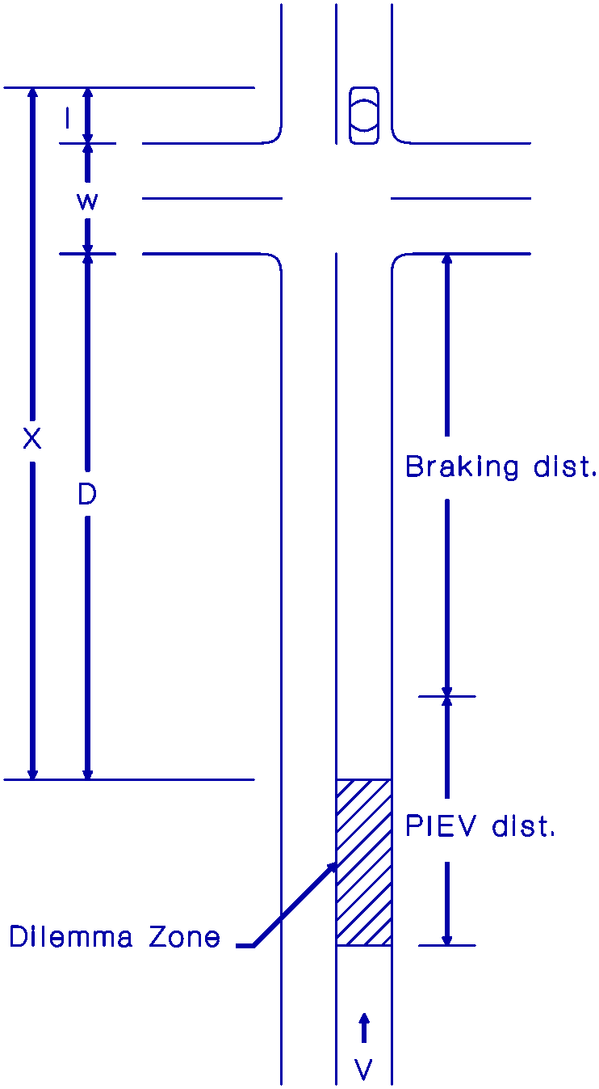
Timing the Change and Clearance Intervals

Slide 11
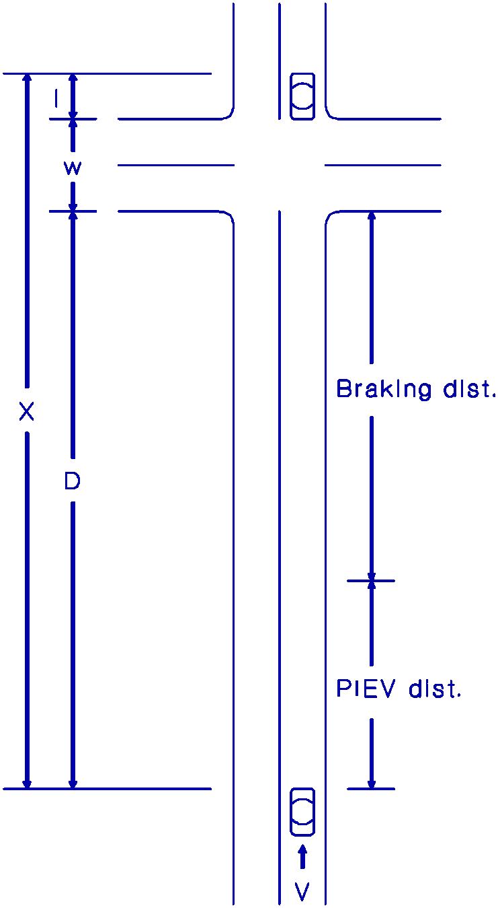
Timing the Change and Clearance Intervals
To eliminate a dilemma zone:
Design Values:
PIEV = 1.0 sec
a = 10 ft/sec²
l = 20 ft.
Round up to nearest 0.5 sec.

Slide 12
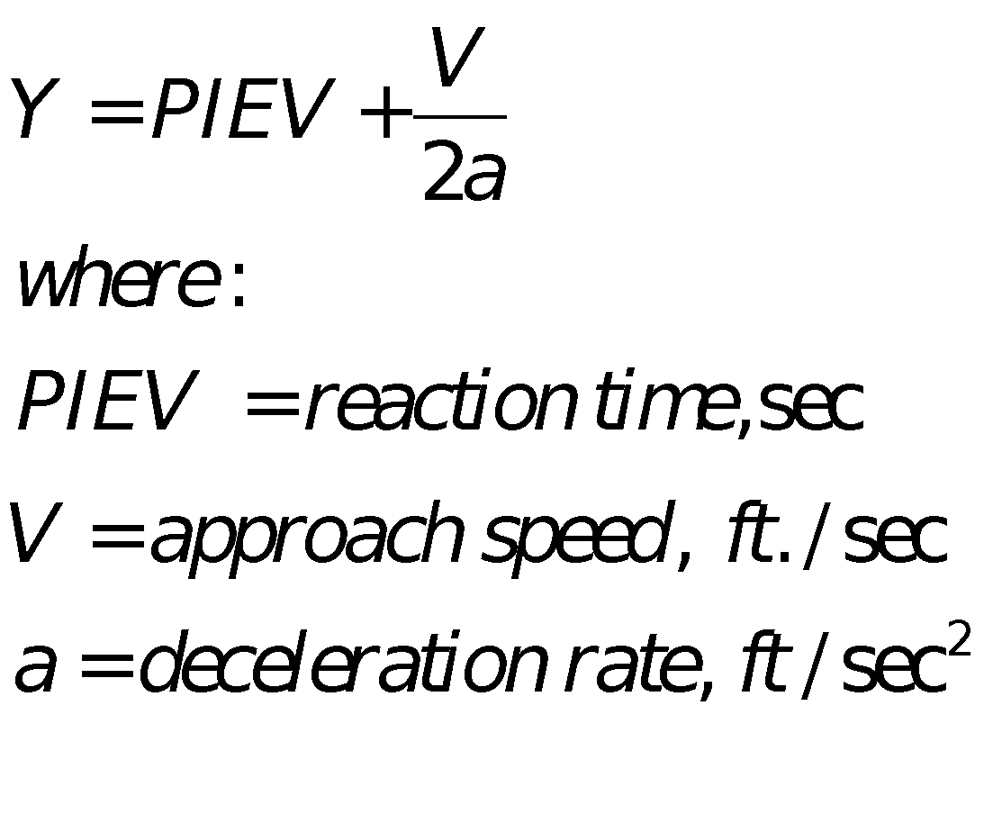
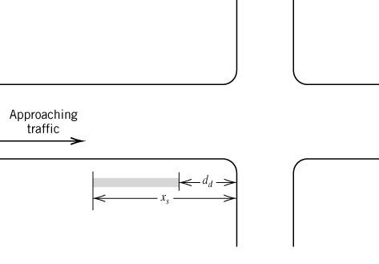
Timing the Change and Clearance Intervals
From Traffic Engineering Handbook:
Change Interval:
Clearance Interval:

Slide 13
Example
Given:
Approach speed = 35 mph
(5280 feet = 1 mile; 3600 sec = 1 hour)
5-lane cross street (each lane is 12’)
Y + AR = 4 sec
Is the existing clearance interval timing satisfactory?
b. If not, determine a suitable clearance interval, and show the location of the dilemma zone for the existing timing on a sketch.

