Slide 1
Introduction to ArtPLAN

Slide 2
Quality and Level of Service
Quality of service (QOS) is a user (traveler) based perception of how well a transportation service or facility operates.
Level of service (LOS) is a quantitative method of identifying quality of service.

Slide 4
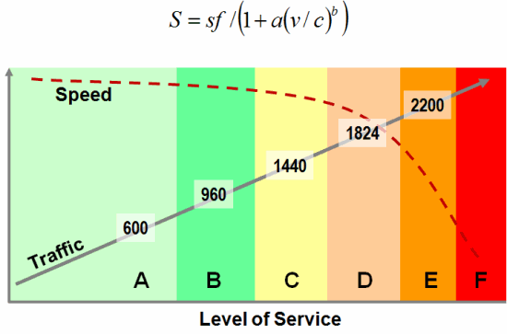

Slide 5
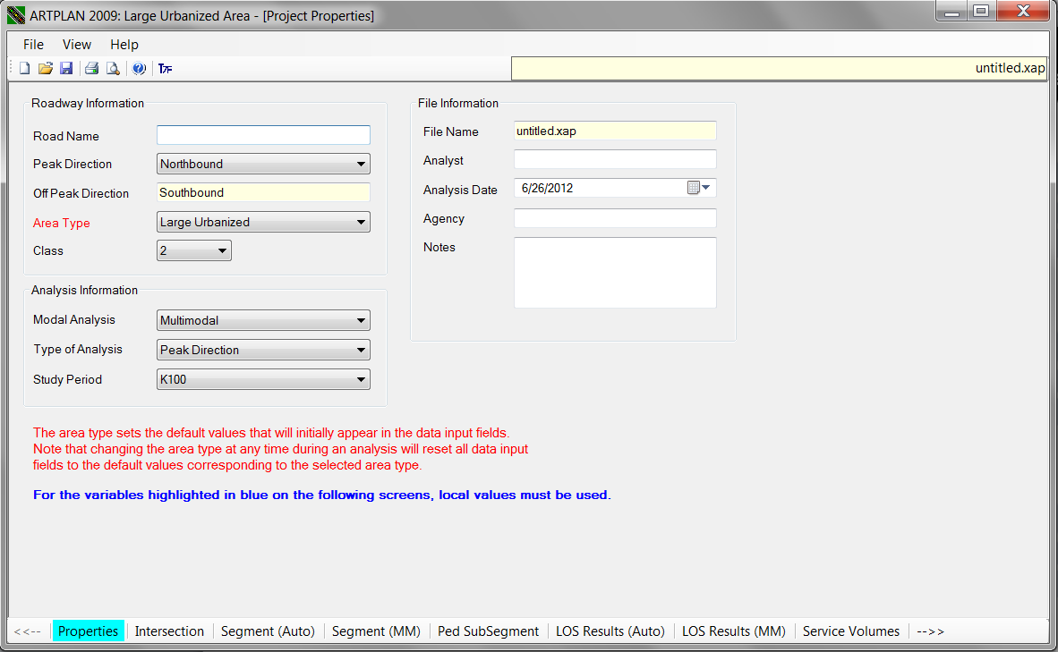

Slide 6
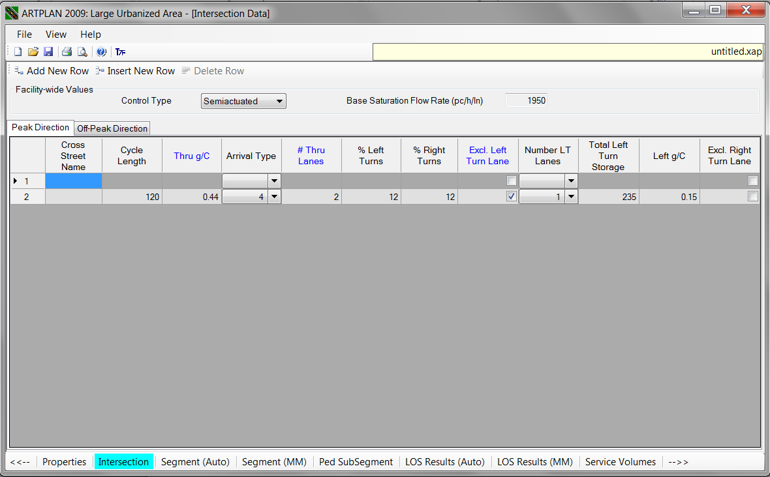

Slide 7
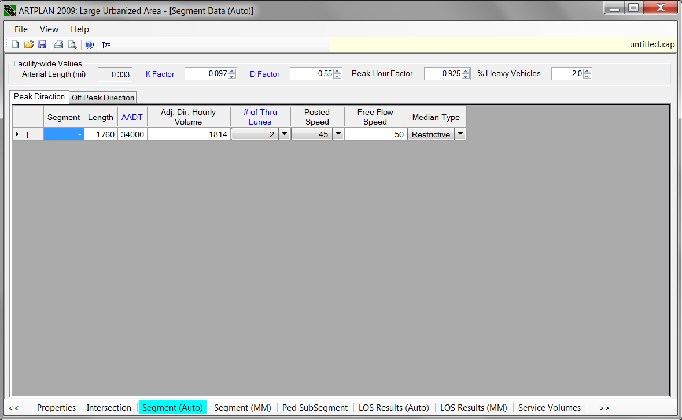

Slide 8
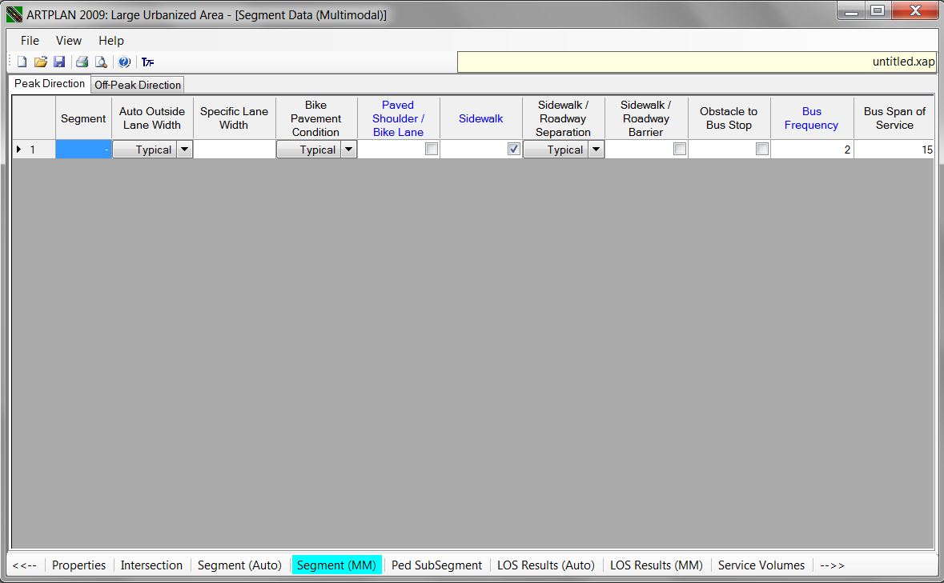

Slide 9
