Slide 1
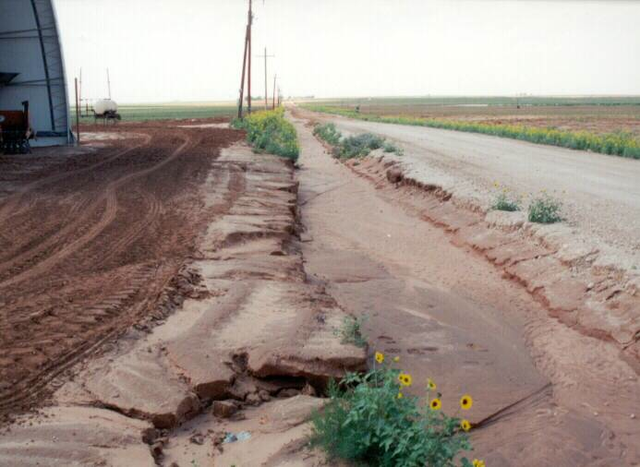
Pavements
The Long and Winding Road

Slide 2
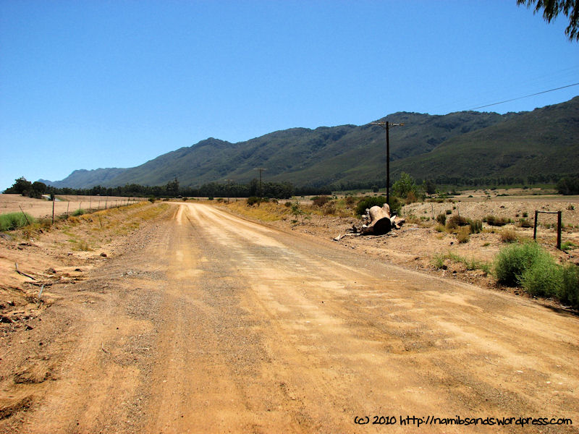

Slide 3
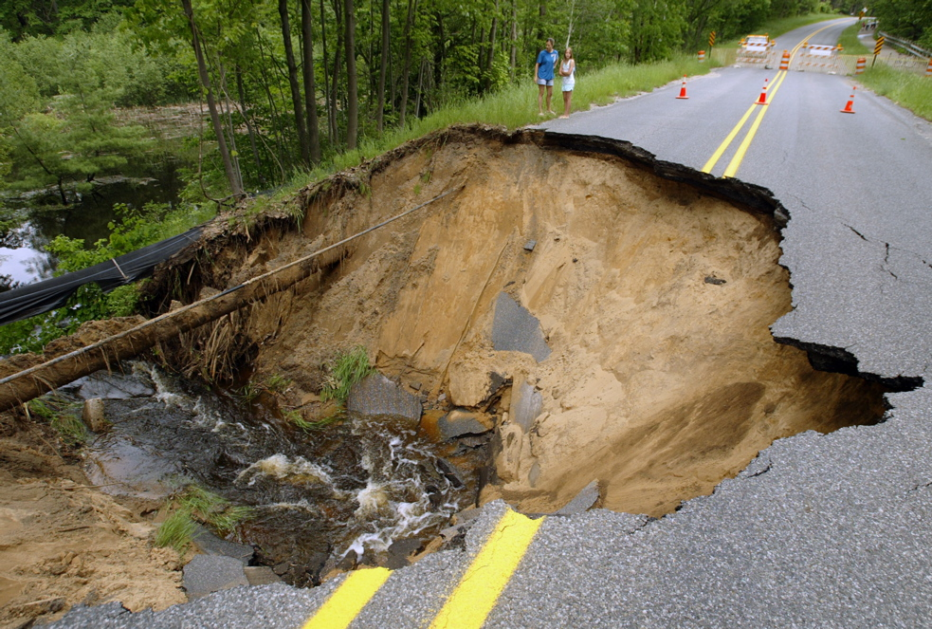

Slide 4
Requirements of a pavement
An ideal pavement should meet the following requirements:
Sufficient thickness to distribute the wheel load stresses to a safe value on the sub-grade soil,
Structurally strong to withstand all types of stresses imposed upon it,
Adequate coefficient of friction to prevent skidding of vehicles,

Slide 5
Requirements of a pavement
An ideal pavement should meet the following requirements:
Smooth surface to provide comfort to road users even at high speed,
Produce least noise from moving vehicles,
Dust proof surface so that traffic safety is not impaired by reducing visibility,

Slide 6
Requirements of a pavement
An ideal pavement should meet the following requirements:
Impervious surface, so that sub-grade soil is well protected,
And long design life with low maintenance cost.

Slide 7
Asphalt Pavement
Asphalt pavement is one of America’s building blocks.
The United States has more than 2 million miles of paved roads and highways, and 94 percent of those are surfaced with asphalt.

Slide 8
Asphalt Pavement
Asphalt pavement material is a precisely engineered product composed of about 95 percent stone, sand, and gravel by weight, and about 5 percent asphalt cement, a petroleum product.
Asphalt cement acts as the glue to hold the pavement together.

Slide 9
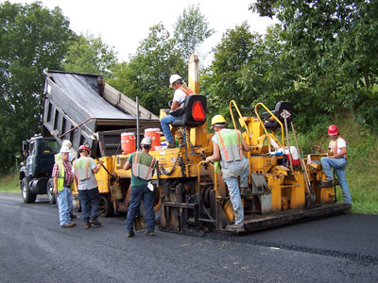
Asphalt Pavement
Asphalt is America’s most recycled material. Reclaimed asphalt is not just reusable as a "black rock" – the asphalt cement in the reclaimed pavement is reactivated to become an integral part of the new pavement.
The recycled asphalt cement replaces part of the new asphalt cement required for the pavement, reducing costs for road agencies.

Slide 10
Asphalt Pavement
Porous asphalt systems earn credit for stormwater management.
Light-colored asphalt helps to mitigate the urban heat island effect.

Slide 11
Asphalt Pavement
The ability to recycle asphalt pavement and the use of asphalt with high percentages of RAP (reclaimed asphalt pavement) make asphalt eligible for credits under the materials and resources heading.

Slide 12
Asphalt Pavement
The fact that asphalt pavement material is produced locally can earn credits for materials and resources.
Warm-mix asphalt offers several advantages which support sustainable development.

Slide 13
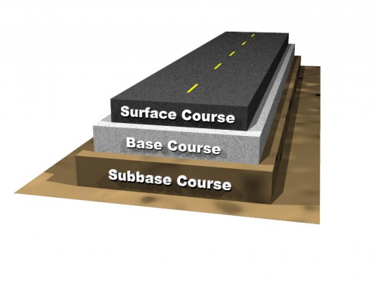

Slide 14
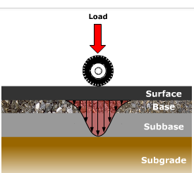
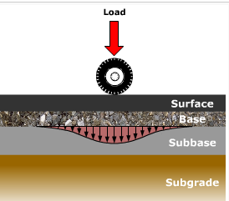
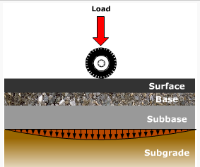
Load Distribution Through Layers

Slide 15
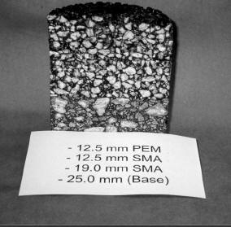
Cross Section of Asphalt Paving

Slide 16
Chocolate Paving
You don’t have to worry about asphalt paving this week.
Instead, you get to worry about making paving using melted chocolate as the binder (taking the place of asphalt).

Slide 17
Chocolate Paving
Like the asphalt, the chocolate you use in this experiment becomes a liquid when heated.
As you mix other ingredients into your "chocolate asphalt" you'll observe your chocolate pavement harden and become stronger as it cools.

Slide 18
Chocolate Paving
Your goal in this section is to make the least expensive, strongest, and lightest pavement that you can from the materials provided
Each of the materials will have a unit cost that you will use to price your pavement
You will make enough pavement to at least have a testable 3 inch wide by 6 inch long strip for testing

Slide 19
Chocolate Paving
The thickness of your pavement will be up to you
Any excess pavement you make can be disposed of in any manner you see fit (you can eat it)
Your pavement will be tested for its flexibility by loading it until it fails (breaks)

