Slide 1
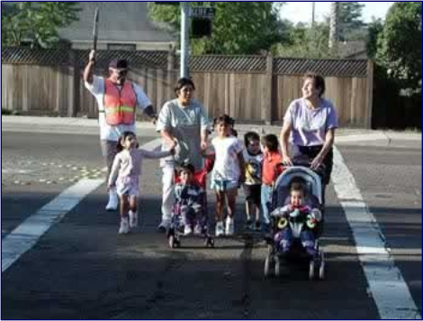
Pedestrian Characteristics
Publication No. FHWA-HRT-05-100
Lesson 8
Notes:
Lesson #: 8
Lesson Title: Pedestrian Characteristics
Learning Objectives:
Upon completion of this lesson, students will be able to:
Describe basic pedestrian characteristics and group types.
Understand walking speeds and how they are used.
Know the space requirements of certain groups.
Discuss the roadway design elements required to accommodate pedestrians with differing abilities.
Preinstruction:
Have the students describe what information they found on their visit to the home page of the U.S. Architectural and Transportation Barriers Compliance Board.
Use the activity provided in the Federal Highway Administration University Course on Bicycle and Pedestrian Transportation Student Workbook (Student Workbook).
Student Participation:
Have the class share their experiences as disabled pedestrians (the preinstruction motivational activity). Focus on what design changes they would make in the local area to better accommodate people with disabilities.
Followup:
Assign reading for lesson 9.
Session Time: 45–60 minutes

Slide 2
Lesson Outline
Pedestrian age groups.
Pedestrians with special needs.
Walking speeds.
Spatial needs.
Americans with Disabilities Act (ADA) design issues.
Notes:
Key Message: Provide the students with an overview of the lesson.
Est. Presentation Time: 1 minute
Suggested Comments:
This slide is optional.

Slide 3
Pedestrian Age Groups
Infants and toddlers (ages 0 to 4).
Young children (ages 5 to 12).
Preteens (ages 13 to 14).
High school aged (ages 15 to 18).
Adults (ages 19 to 40).
Middle-aged adults (ages 41 to 65).
Senior adults (age 65+).
Notes:
Key Message: A pedestrian’s abilities can vary over the course or his or her life. These are somewhat standardized groupings.
Est. Presentation Time: 1–3 minutes
Suggested Comments:
The next seven slides cover some walking behaviors and characteristics typical of the age groups listed here.

Slide 4
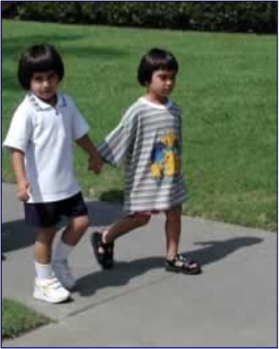
Infants and Toddlers
Just learning to walk.
Developing peripheral vision and depth perception.
Acting impulsively and unpredictably.
Source: PBIC, www.pedbikeimages.org
Notes:
Key Message: A pedestrian’s abilities can vary drastically over the course or his or her life.
Est. Presentation Time: 1–3 minutes
Suggested Comments:
Infants and Toddlers (ages 0 to 4)
At this age, walking skills are just being developed and the children require constant parental supervision. Infants and toddlers are very limited in ability and are vulnerable to traffic collisions.

Slide 5
Young Children
Are impulsive and unpredictable.
Have limited peripheral vision.
Lack experience/training.
Are short and hard for drivers to see.
Are susceptible to darting or dashing into intersections.
Source: PBIC, www.pedbikeimages.org
Notes:
Key Message: A pedestrian’s abilities can vary drastically over the course or his or her life.
Est. Presentation Time: 1–3 minutes
Suggested Comments:
Young Children (ages 5 to 12)
At a young age, children have unique abilities and needs. Since children this age vary greatly in ability, it is important for parents to supervise and make decisions on when their children are ready for a new independent activity. Children in this age range tend to be:
Impulsive and unpredictable.
Limited in their peripheral vision (have trouble locating the source of a sound).
Limited in training/lacking in experience.
Thrilled or excited by close calls.
Short and hard for drivers to see.
Susceptible to darting or dashing into intersections.
Likely to copy the behavior of older people.

Slide 6
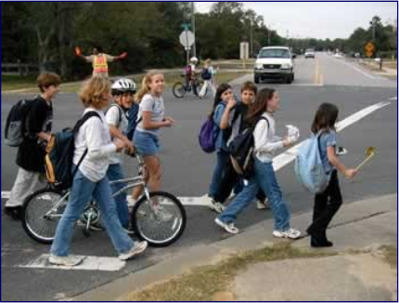
Preteens
Lack experience.
Walk and bicycle more.
Ride more frequently under risky conditions.
Get involved in more intersection dash collisions.
Have a sense of invulnerability.
Source: PBIC, www.pedbikeimages.org
Notes:
Key Message: A pedestrian’s abilities can vary drastically over the course or his or her life.
Est. Presentation Time: 1–3 minutes
Suggested Comments:
Preteens (ages 13 to 14)
By middle school years, children have many of their physical abilities but still lack experience and training. Now there is greater desire to take risk. Preteens generally:
Lack experience.
Walk and bicycle more and at different times (have a higher crash exposure).
Ride more frequently under risky conditions (in high traffic).
Lack positive role models.
Walk across more risky roadways (collectors and above).
Get involved in more intersection dash collisions.
Have a sense of invulnerability that makes them more willing to take chances.

Slide 7
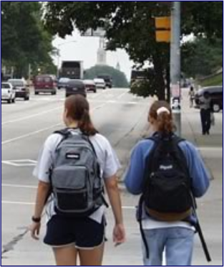
High School Aged
Are very active.
Feel invincible.
Are capable of traveling at higher speeds.
Attempt to use bicycles, skates, etc., based on practices carried over from youth.
Source: PBIC, www.pedbikeimages.org
Notes:
Key Message: A pedestrian’s abilities can vary drastically over the course or his or her life.
Est. Presentation Time: 1–3 minutes
Suggested Comments:
High School Aged (ages 15 to 18)
By high school and college age, exposure changes and new risks are assumed. Many walk and bicycle under low light conditions. Other characteristics of this age group are that they:
Are very active, can go long distances, and visit new places.
Feel invincible.
Still lack experience and training.
Are capable of traveling at higher speeds.
Will overestimate their abilities on hills, curves, etc.
Attempt to use bicycles, in-line skates, etc., based on practices carried over from youth.
Are willing to experiment with alcohol and drugs.

Slide 8
Adults
Are active and fully aware of the traffic environment.
Comprise only 1–4 percent of bicycling population in most communities.
Tend to be very vocal and interested in improving conditions.
Are interested in serving as instructors or task force leaders.
Source: PBIC, www.pedbikeimages.org
Notes:
Key Message: A pedestrian’s abilities can vary drastically over the course or his or her life.
Est. Presentation Time: 1–3 minutes
Suggested Comments:
Adults (ages 19 to 40)
These adults are highly competent in traffic and capable of perceiving and dealing with risk in most circumstances. Some use bicycles for commuting and utilitarian trips, while others use bicycles primarily for recreation. This group generally:
Is active and fully aware of the traffic environment.
Comprises only 1–4 percent of bicycling population in most communities.
Tends to be very vocal and interested in improving conditions.
Has members interested in serving as instructors or task force leaders.

Slide 9
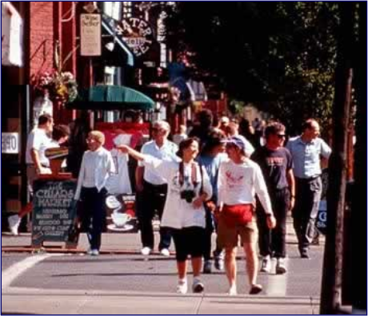
Middle-Aged Adults
Are still active.
May experience a slowing of reflexes, range of motion, and observational skills.
Source: PBIC, www.pedbikeimages.org
Notes:
Key Message: A pedestrian’s abilities can vary drastically over the course or his or her life.
Est. Presentation Time: 1–3 minutes
Suggested Comments:
Middle-Aged Adults (41 to 65)
During this stage of life, many pedestrians experience a slowing of the reflexes necessary to observe, assess, and respond to traffic conditions.

Slide 10
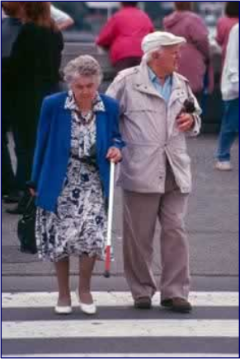
Senior Adults
Walk more for exercise/independence.
Experience a reduction in vision, agility, balance, speed, concentration, and strength.
Have difficulty hearing vehicles approaching from behind.
Have reduced abilities under low light/night conditions.
Source: PBIC, www.pedbikeimages.org
Notes:
Key Message: A pedestrian’s abilities can vary drastically over the course or his or her life.
Est. Presentation Time: 1–3 minutes
Suggested Comments:
Senior Adults (65+)
Senior adults, ages 65 and up, begin a gradual decline in physical and physiological performance, with a rapid decline after age 75. Many are incapable of surviving serious injuries. These changes affect their performance.
Seniors:
Walk more in older years, especially for exercise/independence.
May have reduced income and therefore no car.
All experience some reduction in vision, agility, balance, speed, and strength.
May have further problems with hearing, visual extremes, and concentration.
Have the tendency to focus on only one object at a time.
Have difficulty hearing vehicles approaching from behind.
All have greatly reduced abilities under low light/night conditions.
May overestimate their abilities.
Have a higher fatality rate than other pedestrians involved in collisions with motor vehicles.

Slide 11
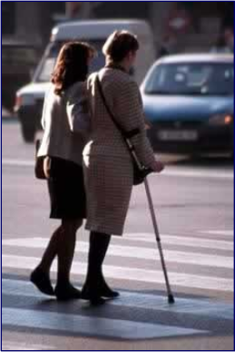
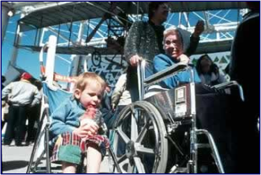
Pedestrians with Different Needs
Children.
Seniors.
Mobility-impaired.
Source: PBIC, www.pedbikeimages.org
Notes:
Key Message: Some pedestrian groups have different needs that must be met in order for them to safely use transportation facilities.
Est. Presentation Time: 3–5 minutes
Suggested Comments:
Children and older pedestrians:
The previous slides have already highlighted several issues related to children and pedestrians.
The mobility-impaired:
For those of us fortunate to live to an older age, 85 percent of us will have a permanent disability that limits our range of mobility. Disabilities are common through all ages, and the permanently disabled constitute at least 15 percent of our population. Those with permanent physical disabilities, often kept away from society in the past, are now walking and bicycling on a regular basis. Many others have temporary conditions, including pregnancy, and broken or sprained limbs that may restrict their mobility. The disabled group includes:
Those who are visually impaired, hearing impaired, mobility impaired, mentally/emotionally impaired, or other.
Many older adults who have reduced abilities.
People who were previously institutionalized and are not trained to walk the streets.
Those dependent on alcohol or drugs who may be hard to recognize.

Slide 12
Walking Speeds
Pedestrian Type
Mean Walking Speed, ft/s
Average adult
4.00
Wheelchair user
3.55
Pedestrian with immobilized knee
3.50
Older/senior adult
2.80
Cane or crutch user
2.62
Below-knee amputee
2.46
Pedestrian with knee arthritis
2.46
Pedestrian with hip arthritis
2.24 to 3.66
Pedestrian with walker
2.07
Above-knee amputee
1.97
4.0 feet per second (ft/s) = 1.2 meters per second (m/s)
Notes:
Key Message: Walking speeds are primarily used to calculate pedestrian clearance intervals for traffic signals. Many walking speeds must be taken into account to provide safety for all the pedestrians that may be crossing the street.
Est. Presentation Time: 2–4 minutes
Suggested Comments:
Pedestrians have a wide range of walking speeds. The Manual on Uniform Traffic Control Devices for Streets and Highways (MUTCD) recommends a speed of 4.0 feet per second (1.2 meters per second) for calculating pedestrian clearance intervals. It also includes a comment that, where pedestrians who walk more slowly than normal or who use wheelchairs routinely use the crosswalk, a walking speed of less than 4.0 feet per second (1.2 meters per second) should be considered in determining pedestrian clearance times. Other studies have identified pedestrian walking speeds ranging from 2.0 to 8.0 feet per second (0.6 to 2.4 meters per second).
A significant proportion (as much as 35 percent) of pedestrians travel at a slower pace than the average person. These slower-walking pedestrians include older pedestrians, people with disabilities, and people pushing baby strollers and/or paying attention to young children walking alongside. Therefore, the slower walking speeds of these groups should be considered when designing pedestrian facilities.

Slide 13
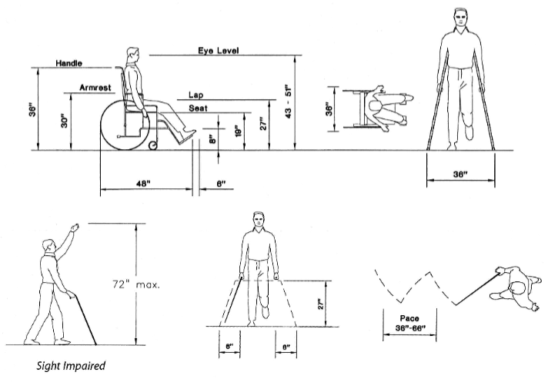
Spatial Needs
Source: Pedestrian Facilities Guidebook
1 inch = 2.54 centimeter
Notes:
Key Message: Different pedestrian groups have different spatial needs as well in order to maneuver comfortably.
Est. Presentation Time: 3 minutes
Suggested Comments:
A standing pedestrian requires 0.3 square meters (3.2 square ft) of space. Two people walking side by side or passing each other while traveling in opposite directions take up an average space of 1.4 meters (4.7 ft), but the minimum width that best serves two pedestrians walking together or passing each other is 6 feet (1.8 meters). Forward clear spaces required by pedestrians range between 1.8 and 11 meters (6 and 35 feet), depending on the activity.
Space requirements for pedestrians with disabilities vary considerably depending on their physical ability and the assistive devices they use. Spaces designed to accommodate wheelchair users are generally considered to be functional and advantageous for most people. The figures in this slide illustrate the spatial dimensions needed for a wheelchair user, a person on crutches, and a sight-impaired person.

Slide 14
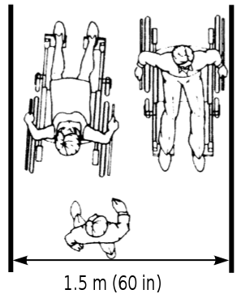
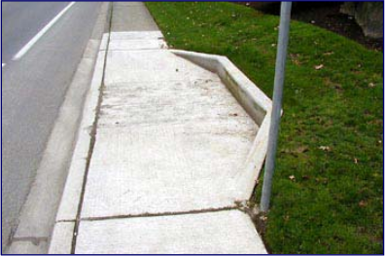
Spatial Needs
Source: ADAAG, http://www.access-board.gov/adaag/html/adaag.htm
Notes:
Key Message: Different pedestrian groups have different spatial needs as well in order to maneuver comfortably.
Est. Presentation Time: 1–3 minutes
Suggested Comments:
Two people walking side-by-side or passing one another generally require almost 1.5 meters (5 ft) of space, whereas wheelchair and scooter users need more space in order to pass one another. The Americans with Disabilities Act (ADA) states that 1.2 meters (48 inches) is the “minimum width needed for an ambulatory person to pass a non-ambulatory person”. However, a clear width of at least 1.5 meters (60 inches) is preferred, especially if the area has a high volume of pedestrians with disabilities. If the width of the sidewalk is less than 1.5 meters (60 inches), two wheelchair users will not be able to pass each other and will have to find a wider place for passing. Passing spaces must be located at reasonable intervals not to exceed 61 meters (200 feet). ADA requirements “specify a minimum space of 60 inches [1.5 meters] in diameter or a 60 inches by 60 inches [1.5 meter by 1.5 meter] T-shaped space for a pivoting 180-degree turn of a wheelchair”. A T-intersection of two corridors or walks is an acceptable passing place. The picture at left shows a passing space interval for a sidewalk that is less than 1.5 meters (60 inches) wide. The figure at right shows the space needed for two wheelchair users to comfortably pass each other.

Slide 15
Accessible Design Issues
Sidewalks.
Ramps.
Street furniture.
Pushbuttons.
Curb cuts/wheelchair ramps.
Notes:
Key Message: Here are some of the most important design elements that must meet ADA guidelines in order to serve the majority of the pedestrian population.
Est. Presentation Time: 1–3 minutes
Suggested Comments:
The following slides discuss the bulleted items.

Slide 16
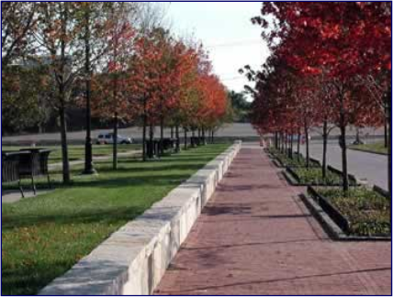
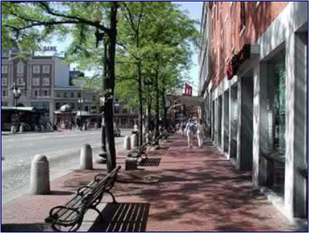
Sidewalks
Source: PBIC, www.pedbikeimages.org
Notes:
Key Message: Proper sidewalk design is imperative to enable pedestrian mobility.
Est. Presentation Time: 1–3 minutes
Suggested Comments:
Sidewalks should be built and maintained in urban areas along all major arterial streets, in commercial areas where the public is invited, and at all transit stops and public areas. They should be paved with a smooth, durable material. It is desirable to have paved sidewalks on both sides of all streets in urban and suburban areas to provide mobility for disabled (as well as other) pedestrians. A planting strip, which serves as a buffer between on-street vehicles and pedestrians on the sidewalk, can be especially beneficial to visually impaired pedestrians on the sidewalk and to wheelchair users. Sidewalks should be kept in good condition, free from debris, cracks, and rough surfaces.
To the extent practicable, sidewalks should have the minimum cross-slope necessary for proper drainage, with a maximum of 1 inch (2.54 centimeters) of fall for every 1.2 m (4 ft) of width (2 percent). A person using crutches or a wheelchair has to exert significantly more effort to maintain a straight course on a sloped surface than on a level surface. Driveway slopes should not encroach into the sidewalk, and a 1.8 meter (6-ft) setback will generally prevent this encroachment.
The sidewalks in the above photos have a very pedestrian-friendly design. They are clean, straight, level, paved, and in good condition. Both have planted tree buffers that provide an attractive environment as well as protection from street traffic. The concrete barrier in the picture at left and the benches in the picture at right provide a resting area for older, disabled, or simply tired pedestrians that does not block the rest of the walkway. They are both wide enough to accommodate wheelchair users and users of other assistive devices.

Slide 17
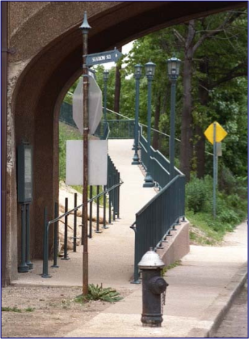
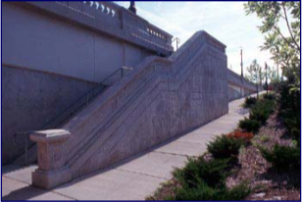
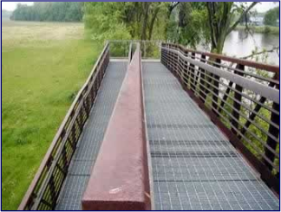
Ramps
Source: PBIC, www.pedbikeimages.org
Notes:
Key Message: ADA-compliant ramps are essential in providing access to buildings and transportation facilities.
Est. Presentation Time: 1–3 minutes
Suggested Comments:
Ramps are defined as locations where the grade exceeds 5 percent along an accessible path. Longitudinal grades on sidewalks should be limited to 5 percent, but may be a maximum of 1:12 (8.3 percent), if necessary (see figures in Student Workbook). Long, steep grades should have level areas at intermittent distances (every 9.1 meters or 30 feet), since traversing a steep slope with crutches, artificial limbs, or in a wheelchair is difficult and level areas are needed for the pedestrian to stop and rest. If there are areas where it is impossible to avoid steep grades, an alternative route (such as an elevator in a nearby building) should be provided. However, ADA does not require accommodations in all locations where natural terrain prevents treatment.
When grades exceed 5 percent, special textures and handrails may be required. Handrails are used by persons in wheelchairs to help pull themselves up and are used by other persons for support. Specifications for ADA-approved handrails can be found in the Americans with Disabilities Handbook. Informational signs, indicating alternative routes or facilities, can be placed at the base of the grade or in a guidebook for the area. Arrangements may be made with the local transit authorities to transport persons with disabilities at reduced (or no) fares where steep grades or other obstacles prohibit or severely impede access.
The top and bottom pictures on the right side of the slide show ADA compliant ramps with and without handrails that have a low slope. The picture at left shows a less-optimal situation: a ramp with a fairly steep slope, street lamps along the path that limit the available width of the ramp, a stop sign at the bottom of the ramp that would be hard to pass in a wheelchair, and a fire hydrant in the middle of the sidewalk that completely blocks the path for wheelchair users.

Slide 18
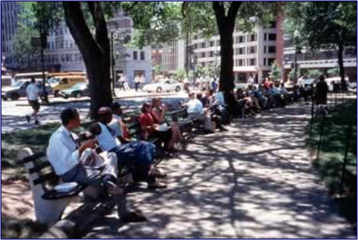
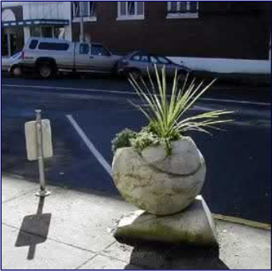
Street Furniture
Source: PBIC, www.pedbikeimages.org
Notes:
Key Message: Street furniture is an important part of the pedestrian environment, but it should comply with certain ADA requirements.
Est. Presentation Time: 1–3 minutes
Suggested Comments:
Street furniture, such as benches, plant holders, and bus shelters, should be out of the normal travel path to the extent possible. For greater conspicuity, high-contrast colors, such as red, yellow, and black, are preferable. See the Student Workbook for guidelines that should be considered in the positioning of street furniture. A common problem for wheelchair users is the placement of street furniture next to on-street parking, which can make exiting a car or lift-equipped vehicle difficult. One remedy is to relocate the street furniture toward the end of the parking space instead of the center, or at the back of the sidewalk furthest from the curb. At least 1.5 meters (5 feet) of clear space width along the sidewalk is needed to allow for exiting a vehicle. Other objects, such as streetlight poles, may be more difficult to move, so consideration may be given to relocating the accessible parking space or reserving extra accessible parking spaces.
In the pictures in this slide, the left one shows a row of benches that offer rest for pedestrians without blocking the wide sidewalk in front of them. The picture at right shows a decorative plant holder placed at the front end of a parking space so as to not hinder street parking or car-exiting by wheelchair users.

Slide 19
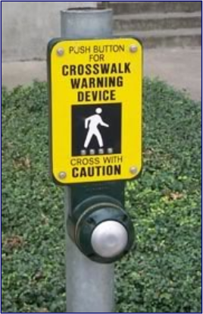
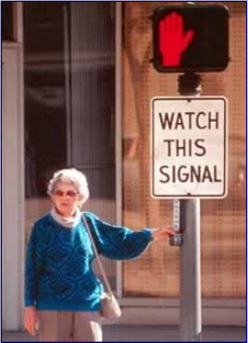
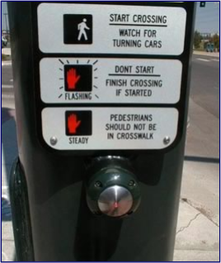
Pushbuttons
Source: PBIC, www.pedbikeimages.org
Notes:
Key Message: Pushbuttons are used to actuate pedestrian crossing signals and should be accessible to all pedestrians.
Est. Presentation Time: 1–3 minutes
Suggested Comments:
Some individuals may have difficulty operating pedestrian pushbuttons. In some instances, there may be a need to install a larger pushbutton or to change the placement of the pushbutton. Pedestrian pushbuttons should always be easily accessible to individuals in wheelchairs, and should be no more than 1.2 meters (48 inches) above the sidewalk (see figures in Student Workbook for reach restrictions) to be within the reach limits of wheelchair users. The force required to activate the pushbutton should be no greater than 2.3 kilograms (5 pounds).
Pedestrian pushbuttons should be located next to the sidewalk landing, the top of the ramp, and adjacent to the appropriate crosswalk ramp. If there are two pushbuttons at a corner (one for each crosswalk), the pushbuttons should be located on separate poles and adjacent to their respective ramps.
The pictures on this slide show three different types of pushbuttons and their respective signs.

Slide 20
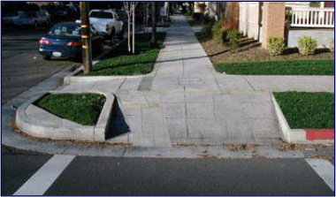
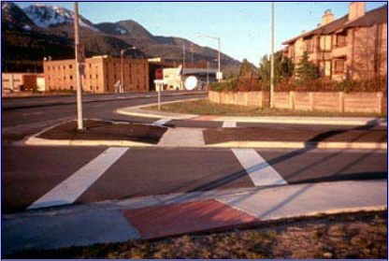
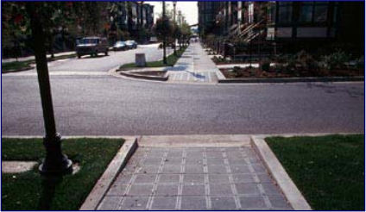
Curb Cuts/Wheelchair Ramps
Source: PBIC, www.pedbikeimages.org
Notes:
Key Message: Curb cuts and wheel chair ramps are another important ADA consideration.
Est. Presentation Time: 1–3 minutes
Suggested Comments:
The single most important design consideration for persons in wheelchairs is to provide curb cuts. New and rebuilt streets with sidewalks should always have curb cuts at all crosswalks. A roll curb (i.e., one with a sloped rather than a vertical curb face) is a barrier and will not allow for wheelchair access. Curb cuts should be at least 0.9-meters wide (36-inches wide) at the base, exclusive of flared sides. The flared sides should not exceed a slope of 1:10 or 1:12 if the sidewalk width in front of the curb ramp is less than 1.2-meters wide (48-inches wide) (see figures in the Student Workbook).
It is desirable to provide two curb cuts per corner. Single ramps located in the center of a corner are less desirable than a separate ramp for each crosswalk to accommodate disabled pedestrians and should not be built for newly constructed or reconstructed sidewalks. Separate ramps provide greater information to visually impaired pedestrians in street crossings, especially if the ramp is designed to be parallel to the crosswalk. The top and bottom left pictures show corners with two curb cuts each and ramps leading directly to the crosswalk. The picture at right shows a curb cut leading to a crosswalk and a curb cut through a median that allows pedestrians a refuge between street crossings.

Slide 21
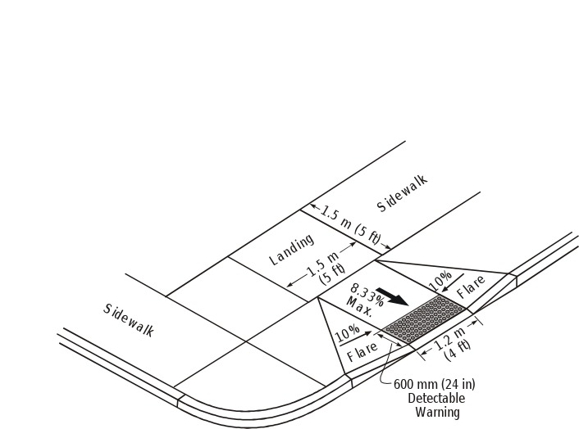
Curb Ramp Slopes
Notes:
Key Message: Curb Ramp Slope and Dimension Requirements
Est. Presentation Time: 2 minutes
Suggested Comments:
Discuss the use of the:
Ramp width.
Ramp slope.
Flare slopes.
Landings.
Detectable warnings.

Slide 22
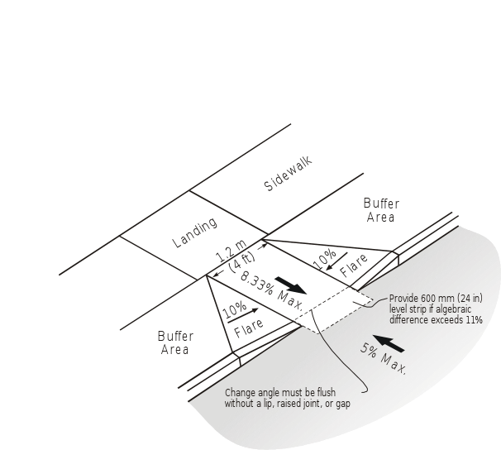
Slope and Counter Slope
Notes:
Key Message: Slope and counter slope dimensions
Est. Presentation Time: 2 minutes
Suggested Comments: No lip, gap, or joint is permissible at the base of the ramp. Slope and counter slope must have an algebraic difference of less than 11%. If not, then a 0.6 meter (2-foot) level landing is required. Detectable warnings, ramp dimensions, etc., are covered in the previous slide.

Slide 23
Lesson Summary
Pedestrians can have many different needs and abilities.
Accessible design will allow ALL pedestrians to more easily and safely navigate the system.
Notes:
Key Message: Summarize the lesson and discuss any questions or issues with students.
Est. Presentation Time: 3–5 minutes
Suggested Comments:
Summarize the lesson and discuss any questions or issues with students.

