Slide 1
Safe Routes to School (SRTS)

Slide 2
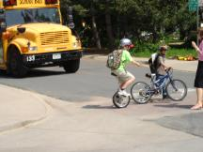
Safe Routes to School (SRTS)
National Safe Routes to School Program was established in 2005
Federally funded through SAFETEA-LU
$612 million over FY 2005-2009
Goal: To provide support and funding for changes to communities to make walking and bicycling to school a safe and more popular activity
Source: www.bikeped.org/Katy Jones
Notes:
Safe, Accountable, Flexible, and Efficient Transportation Equity Act: A Legacy for Users Act (SAFETEA-LU), and administered through each individual state DOT.
Focus on walking and bicycling to impact health (childhood obesity), also air pollution benefits. Stats: Diversion of just 15% from auto to walk/bike can make difference between attainment/non-attainment Other benefits include improved health (active transportation), improved test scores (exercise boosts cognitive functions), etc.
In 1969, nearly half of all children walked or biked to school- this is now down to less than 15%.

Slide 3
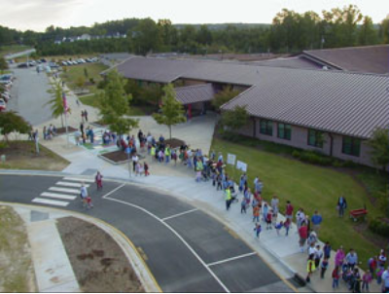
Safe Routes to School Requirements
The 5 E’s:
Engineering
Enforcement
Encouragement
Education
Evaluation
Notes:
Key here is that all of these aspects must be addressed in SRTS proposals- requires multidisciplinary collaboration – 1st hint at best practices Safe Routes to School programs can increase walking and bicycling to school by 20%. This is key as much as 21 % of morning traffic is generated by parents driving their children to school. Combined emissions from numerous private vehicles can add up to the single greatest cause of pollution in many US Cities. (NSRTSTask Force, 2008).

Slide 4
Best Practices - Engineering
Sidewalks
Constructing sidewalks on streets near schools can drastically increase pedestrian safety for children and their families. Studies reveal that pedestrians are more than twice as likely to be struck by a vehicle in locations without sidewalks.
Safe Routes to School: Putting Safety First (2009)
Pavement Markings/Signage
Traffic Calming
Infrastructure improvements for traffic calming have been shown to reduce the risk of pedestrian-vehicle conflicts by 25-66%.
Safe Routes to School State Network Project: Final Report 2007-2009 (2009)
Network approach (complete streets)
Notes:
A pedestrian hit by a vehicle traveling 20 mph has a 95 percent chance of surviving. If the vehicle is traveling at 30 mph, chances of survival decrease to 55 percent. At 40 mph, only 15 percent of pedestrians can expect to survive.
Safe Routes to School programs are most effective when implemented in conjunction with local Complete Streets policies.

Slide 5
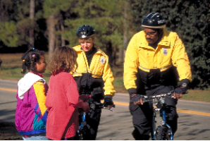
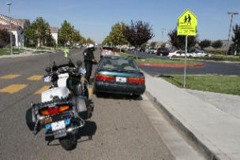
Best Practices - Enforcement
Very effective when police are present
Intermittent does not work
Source: www.bikeped.org/Dan Burden
Source: www.bikeped.org/Dan Burden
Notes:
Expensive; reduces speeds, improves yielding to peds when police are present

Slide 6
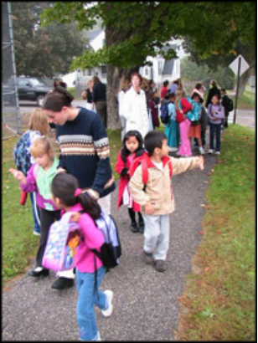
Best Practices - Encouragement
Stakeholder engagement
Walking school buses
Make sure students are actively involved!
Notes:
Getting stakeholders engaged and taking ownership (particularly kids) is the best way to promote sustainable practices; must have buy-in from the school admin as well.

Slide 7
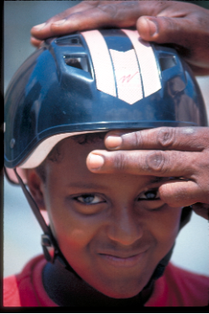
Best Practices - Education
Education is necessary at multiple levels
Students
Parents
School officials
Community
Local officials
Source: www.bikeped.org/Dan Burden
Notes:
Policy and decision making- here can talk about school siting decisions, coordinated school health, policies regarding complete streets, etc.

Slide 8
Best Practices – Traffic Control Plans
Separate automobiles from pedestrians
Identify specific clear traffic flow patterns
Include drop off / pick up lane
Include queuing space (on or off site)
Identify adult assistants to enforce policies and help students enter and exit
Provide bus lane to move busses quickly
Stagger final bell schedule

