Slide 1
Foam Shapes
BY: Lauren Mitchell

Slide 2
Content covered by this kit
1
Elementary
2
Middle
3
Highschool
Learning 2-d shapes and their attributes
Learning 3-d shapes and their attributes
Calculating the volume of 3-d shapes

Slide 3
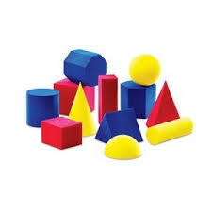
Each box contains a Varity of shapes in A single color
Figure 1: Foam Shape example

