Slide 1
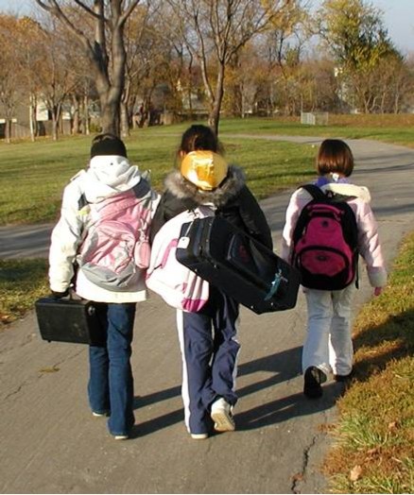
Safe Routes to School
Improving Health, Safety and Transportation
Lenexa, KS
Notes:
To the presenter:
This presentation provides a brief overview of Safe Routes to School Programs and why they are important.
Each slide contains speaker notes with key points and citations are provided where relevant. Where appropriate, image location information has been placed on the slide for the audience to see.
Please go to www.saferoutesinfo.org for further information on any of the topics mentioned in this presentation.
Learning objectives:
Upon completion of this presentation, listeners will:
Be able to explain why fewer children are walking and bicycling to school and what caused this shift from several decades ago.
Be able to describe the consequences of fewer children walking and bicycling to school.
Be able to describe elements of Safe Routes to School programs.
Image:
Christa McAuliffe Elementary School, Lenexa, KS, provided by Mike Cynecki.

Slide 2
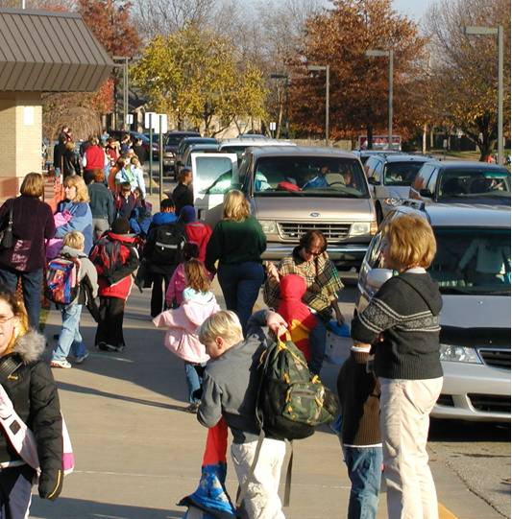
The need for Safe Routes to School
Fewer kids today walk and bike to school
Unintended consequences have resulted
SRTS programs are part of the solution
Notes:
Message:
I’m here today to talk about the benefits of walking and bicycling for children, what’s getting in the way and how SRTS programs can help. Let’s begin by framing the issue:
A major decrease in the number of children who walk and bicycle to school has occurred over the last generation or so.
This decline has resulted in unintended and far-reaching consequences for both our children’s lives and our own.
Safe Routes to School programs empower communities to make walking and bicycling to school a safer, more popular way to get to school.
Let’s explore these areas in more detail.
Image:
Christa McAuliffe Elementary School, Lenexa, KS, provided by Mike Cynecki.

Slide 3
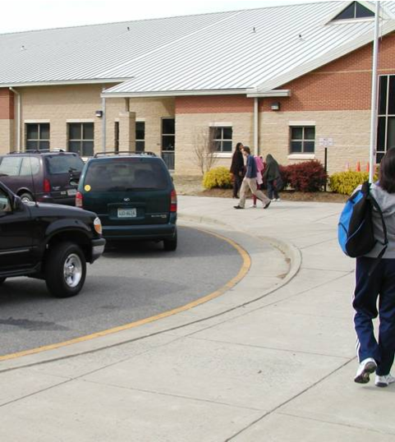
1. Fewer kids are biking and walking. More parents are driving.
2001: 16% walked
1969: 42% walked
(CDC, 2005)
Notes:
Message:
Today fewer children are walking and biking and more parents are driving.
Only a generation ago, children routinely traveled around their neighborhoods either on foot or on bike. Walking and bicycling were common ways to get to school.
Today, few children (ages 5 to 18 yr. old) walk or bike.*.
And as traffic increases, parents become even more convinced that it is unsafe for their children to walk. They begin driving their children to school, thereby adding even more cars to the morning chaos.
*U.S. Centers for Disease Control and Prevention. Kids Walk-to-School: Then and Now—Barrier and Solutions. Available: http://www.cdc.gov/nccdphp/dnpa/kidswalk/then_and_now.htm Accessed: January 17, 2006.
Note to presenter:
Optional: Ask all of the adults in the room who walked or bicycled regularly to school to raise their hands. Now ask how many have children in their lives (sons, daughters, grandchildren, neighbors) who walk or bike to school. There’s likely a large difference.
Image:
Linwood Holton Elementary School, Richmond, VA, provided by Mike Cynecki.

Slide 4
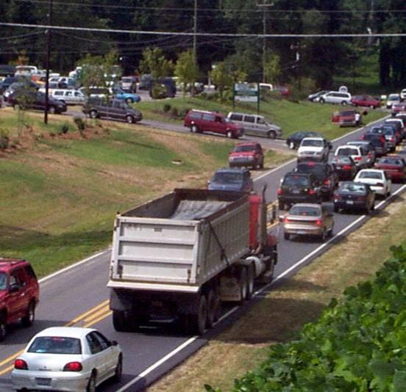
Parents driving
Parents driving children to school:
20%-25% of morning traffic
(NHTSA 2003; Dept. of Environment)
Notes:
Message:
For most communities, this picture is the norm.
Parents driving their children to school make up 20-25 percent of the morning commute.*, **
*Department for Environment, Transport and the Regions, England: Greater Vancouver Regional District: Morning Peak Trip by Purpose cited in Safe Routes to School: Education, Engineering and Enforcement for CA Communities. http://www.dhs.ca.gov/epic/sr2s/documents/SfRts4pg.pdf
**National Highway Transportation Administration cited in “Safe Routes to School: Pledging Safe Communities for Our Children.” (2003) http://www.bikeleague.org/educenter/srts_pledge.pdf
Image:
Unknown location, provided by Dan Burden.

Slide 5
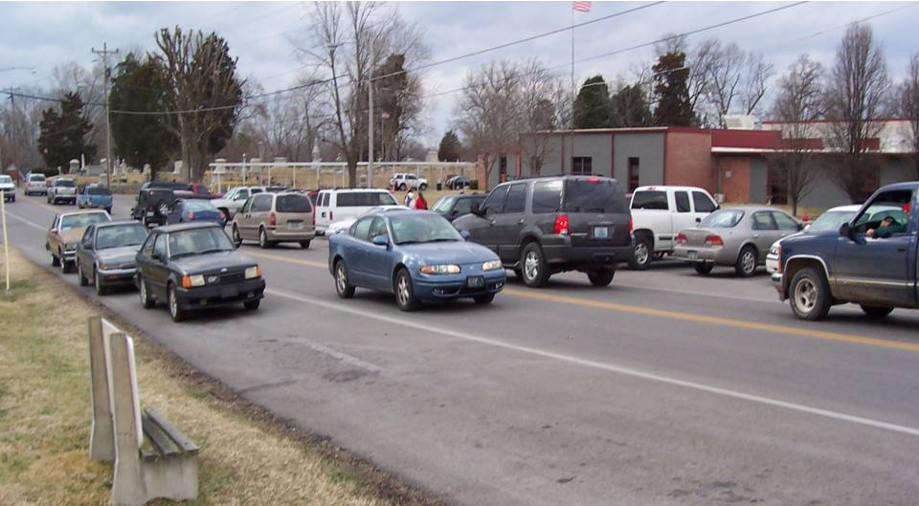
What caused the shift?
Notes:
Message:
Let’s dig a little deeper to discover the underlying reasons for this shift in transportation habits.
How have schools changed?
How have parents and students changed?
What are the community issues involved?
Image:
Second Street School, Frankfort, Kentucky, provided by Mike Cynecki.

Slide 6
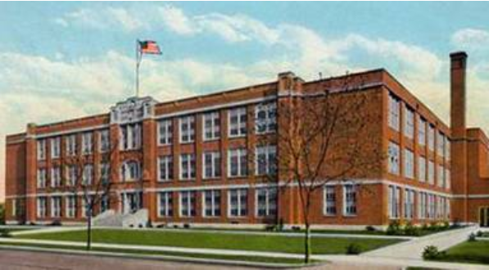
School siting issues: A generation ago
Small schools
Located in community centers
(EPA, 2003)
Notes:
Message:
School location has changed a lot in recent years.
A generation or more ago, schools were small and located in the centers of communities.
The close proximity of schools to residential neighborhoods encouraged walking and biking.*
*Travel and Environmental Implications of School Siting, Environmental Protection Agency, Report No. 231-R-03-004, October 2003, available online at: http://www.smartgrowth.umd.edu/pdf/SchoolLocationReport.pdf.
Image:
Welty Middle School, New Philadelphia, OH, provided by http://www.quakerfoundation.org/misc/archives/weltyold.jpg.

Slide 7
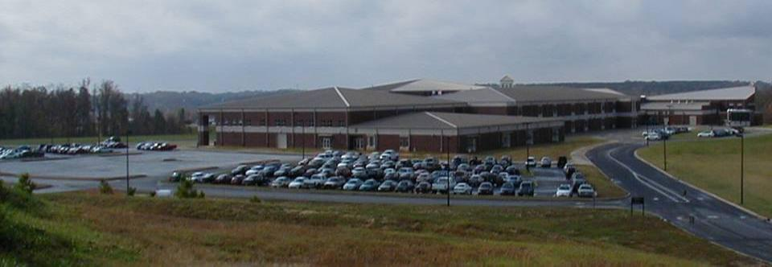
School siting issues: Today
Mega-schools
Built on edges of towns and cities
Notes:
Message:
Today, schools are built to accommodate a far larger number of students.
Schools are increasingly being built on large pieces of fringe land on the periphery of towns and cities.
This means that neighborhoods often aren’t connected to schools.
The reasons for this change include current land use patterns, school siting standards, lack of coordination between planners and school officials and lower up-front costs for land.
Image:
Dorman High School, Roebuck, SC, provided by Mark Fenton.

Slide 8
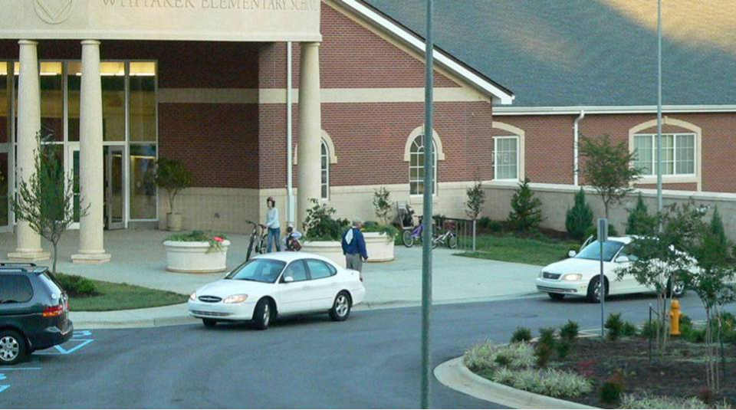
School consolidation has lengthened the trip between home and school
Notes:
Message:
By increasing the distance between home and school, these larger, more distant schools often remove the option of physically active trips to school and encourage higher levels of auto use and pollution.
Image:
Whitaker Elementary School Winston-Salem, NC, provided by Mike Cynecki.

Slide 9
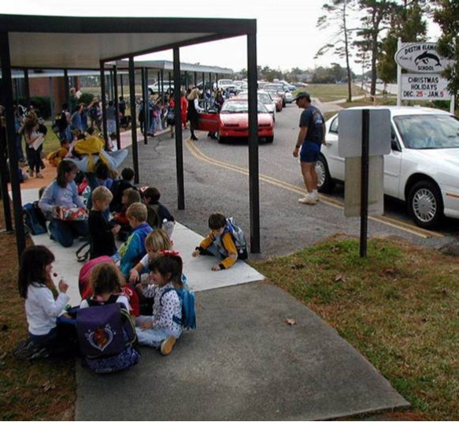
It’s not just distance
Students who live within 1 mile and walk or bike:
2001: 63%
1969: 87%
(CDC, 2005)
Notes:
Message:
Even when children live within one mile of school, fewer are walking and bicycling than in the past.*
*U.S. Centers for Disease Control and Prevention. Kids Walk-to-School: Then and Now—Barrier and Solutions. Available: http://www.cdc.gov/nccdphp/dnpa/kidswalk/then_and_now.htm Accessed: January 17, 2006.
Image:
Destin Elementary School, Destin, FL, provided by Dan Burden, available from PBIC Image Library.

Slide 10
Most common barriers to walking and bicycling to school
Long distances 62%
Traffic danger 30%
Adverse weather 19%
Fear of crime danger 12%
Note: Sum of percentages is more than 100% because respondents could identify more than one barrier.
(CDC, 2005)
Notes:
Message:
The Centers for Disease Control and Prevention studied how many children walk and bike to school, and what barriers parents report that keeps them from allowing their children walk or bicycle.
Parents say that distance (which we’ve already discussed), traffic dangers, and adverse weather are the main reasons why their children don’t bike or walk to school.*
* U.S. Centers for Disease Control and Prevention. Barriers to Children Walking to or from School United States 2004, Morbidity and Mortality Weekly Report September 30, 2005. Available: www.cdc.gov/mmwr/preview/mmwrhtml/mm5438a2.htm. Accessed: December 28, 2005.
Note to presenter: Survey respondents could identify more than one barrier so the sum of the percentages is more than 100%. Two additional barriers with least responses include: opposing school policy (6%) and other reasons (11.7%).

Slide 11
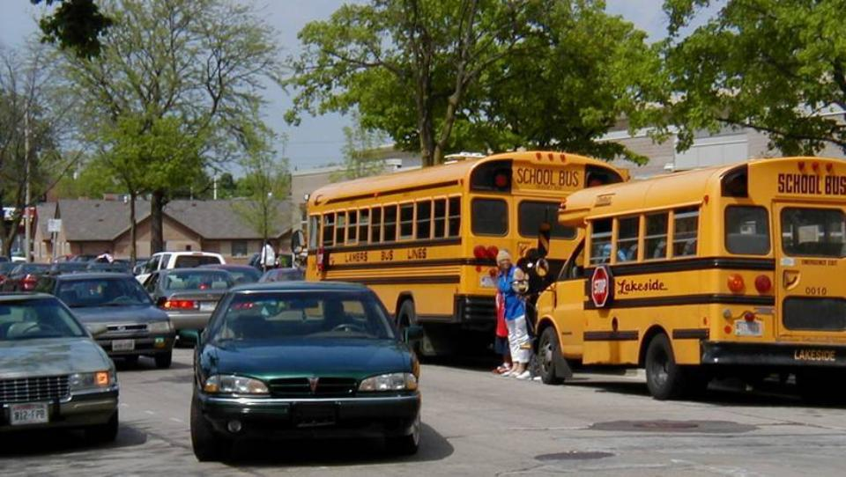
Traffic danger
Notes:
Message:
Another barrier given for walking and bicycling to school was traffic – parents feeling it is not safe for their children to walk or bike.
Safety concerns lead parents to drive their children to school, making it even less safe for others to walk and bike.
Image:
Browning Elementary, Milwaukee, WI, provided by Mark Fenton.

Slide 12
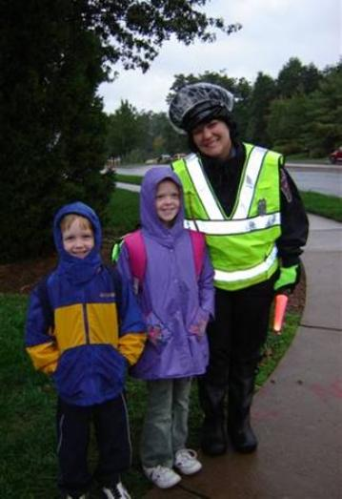
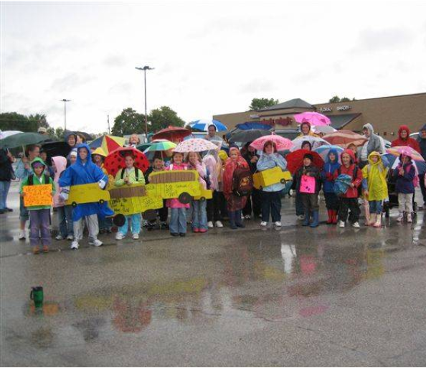
Adverse weather
Centreville, VA
Howard’s Grove, WI
Notes:
Message:
Adverse weather was the third most-cited reason parents gave for their children not walking or bicycling to school.
However, the weather hasn’t changed much since a generation ago when so many children walked or biked.
Safe Routes to School efforts have been very successful in climates with all kinds of weather, from cities across Canada to Chicago, IL and Minneapolis, MN and Arlington, MA.
Images:
(l) Centreville Elementary, Centreville, VA, provided through www.iwalktoschool.org.
(r) Northview Elementary, Howard’s Grove, WI, provided through www.iwalktoschool.org

Slide 13
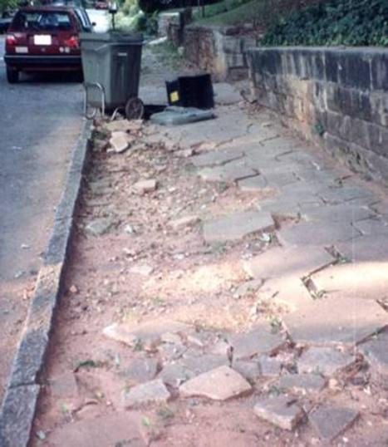
Individual community issues
Fear of crime (both real and perceived)
Abandoned buildings
Other reasons
Notes:
Message:
Parents often state being fear of crime as an obstacle to walking and bicycling to school.
Each community has its own issues that inhibit the ability to walk and bike to school.
Communities have cited issues like abandoned buildings and stray dogs as disincentives to walking and biking to school.
Programs need to identify the real dangers and the perceptions and address both.
Whether real or perceived, these fears affect how many children are allowed to walk or bicycle to school.
Image:
Provided by Michael Ronkin.

Slide 14
2. What are the unintended consequences of less walking and bicycling?
For the environment
For individual health
Notes:
Message:
Some may ask: So what if children are driven everywhere? Why does it matter?
Now let’s take a look at the unintended environmental and health consequences of less walking and bicycling.

Slide 15
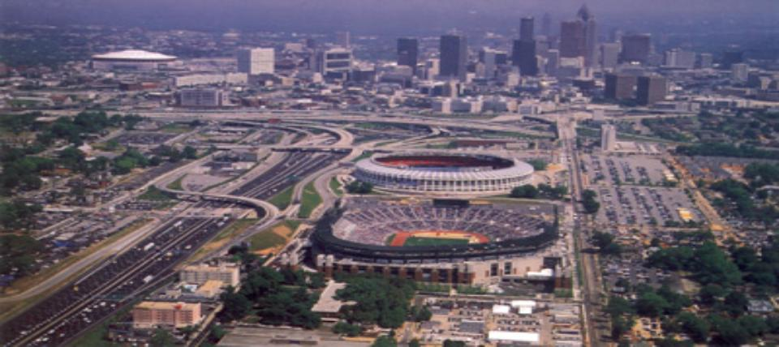
1996 Summer Olympic Games banned single occupant cars in downtown Atlanta
Atlanta, GA
Notes:
Message:
The 1996 Olympics in Atlanta was an opportunity to examine the relationship of traffic, air quality and health.
During the 1996 Summer Olympic Games in Atlanta, the city virtually banned single occupant cars in downtown Atlanta in order to prevent gridlock.
The Journal of the American Medical Association (JAMA) published a study of the ban and its effects, which showed a clear relationship between traffic reduction and reduced incidents of asthma.*
*Michael S. Friedman et al, “Impact of Changes in Transportation and Commuting Behaviors During the 1996 Summer Olympic Games in Atlanta on Air Quality and Childhood Asthma,” JAMA, Vol. 285, Feb 2001, pp. 897 - 905.
Image:
From http://olympics.ballparks.com/1996Atlanta/index.htm

Slide 16
Results of the ban
Morning traffic –  23%
Peak ozone –  28%
Asthma-related events for kids –  42%
(Journal of the American Medical Association [JAMA], 2001)
Notes:
Message:
The results of the study showed:
Morning rush hour traffic volumes decreased by more than 23%.
This decreased the peak amount of ozone by 28% during the 17 days of the Olympics.
The need for healthcare related to asthma for kids decreased by 42% during the games.*
Reducing auto emissions by encouraging alternative forms of transportation, such as walking and biking can help improve the health of children and adults.
*Michael S. Friedman et al, “Impact of Changes in Transportation and Commuting Behaviors During the 1996 Summer Olympic Games in Atlanta on Air Quality and Childhood Asthma,” JAMA, Vol. 285, Feb 2001, pp. 897 - 905.

Slide 17
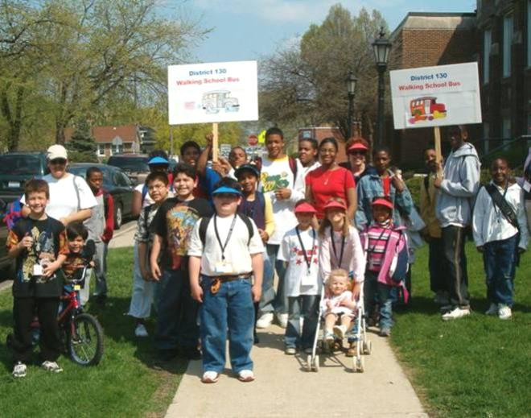
Air quality
Measurably better around schools with more walkers and bicyclists
(EPA, 2003)
Chicago, IL
Notes:
Message:
One of the benefits of SRTS programs is that they help to reduce auto emissions by encouraging alternative forms of transportation, such as walking and biking.
An EPA report found that:
Schools placed in neighborhoods near residential areas with a good street and sidewalk network have more students arriving by bicycle and on foot.
Air quality is measurably better at such locations.*
*Travel and Environmental Implications of School Siting, Environmental Protection Agency, Report No. 231-R-03-004, October 2003, available online at: http://www.smartgrowth.umd.edu/pdf/SchoolLocationReport.pdf.
Image:
Blue Island Walking School Bus, Chicago, IL, provided by Melody Geraci.

Slide 18
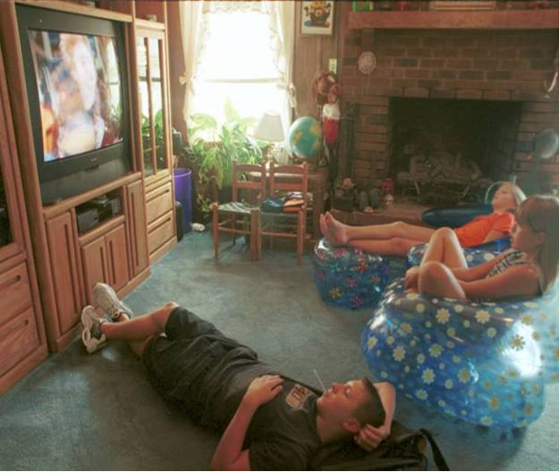
Physical inactivity
Most kids aren’t getting the physical activity they need
Recommended 60 minutes on most, preferably all, days of the week
(US Depts. of Health and Human Services and Agriculture, 2005)
Notes:
Message:
We’ve talked about health as far as air quality is concerned. Another major health factor is the need we all have to be physically active. Many kids today are not getting the physical activity that they need.
Kids today are less active due to many factors, some of which include:
(1) They are driven more often to school,
(2) They are offered less PE or recess during the school day*
Children need at least one hour of moderate activity a day, and ideally more.**
* Brener N, Burstein G, DuShaw M, Vernon M, Wheeler L, Robinson J. Health services: results from the School Health Policies and Programs Study 2000. Journal of School Health. 2001 Sep;71(7):294-304.
**US Depts of Health and Human Services and Agriculture. Physical activity recommendations for young people. Accessed at http://www.cdc.gov/nccdphp/dnpa/physical/recommendations/young.htm.
Image:
Chapel Hill, NC, provided by the Pedestrian and Bicycle Information Center.

Slide 19
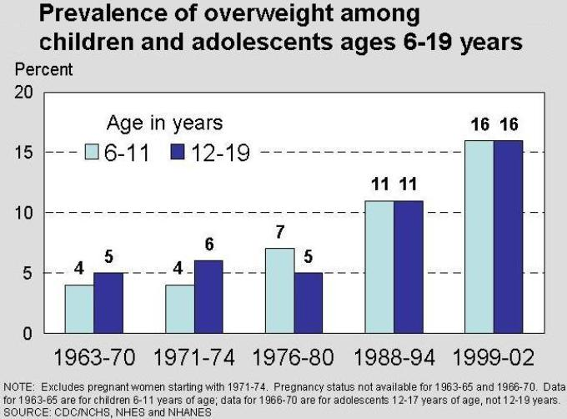
U.S. youth overweight rates
(National Center for Health Statistics)
Notes:
Message:
Less active children are more likely to be overweight.*
So while kids are getting less activity, the proportion of overweight children has been increasing dramatically.
The percentages of 6-11 and 12-19 year-old kids considered severely overweight have tripled in the last 30 years.**
Diet is certainly a factor as well, and many schools have adopted wellness policies that incorporate Safe Routes to School and healthy eating campaigns.
Note: These data show the percentage of American children in two age groups whose weight is higher than the 95th percentile of the recommended weight for their height. The medical community doesn’t yet define “obesity” for children (such as a BMI over 30, as it does for adults).
*American Academy of Pediatrics (2003). “Policy statement on the prevention of pediatric overweight and obesity.” http://aappolicy.aappublications.org/cgi/content/full/pediatrics;112/2/424
**Hedley AA, Ogden CL, Johnson CL, Carroll MD, Curtin LR, & Flegal KM. (2004). Prevalence of overweight and obesity among US children, adolescents, and adults, 1999-2002. JAMA, 291(23):2847-50.
Image:
National Center for Health Statistics Image source: U.S. Centers for Disease Control and Prevention. National Center for Health Statistics. Prevalence of Overweight Among Children and Adolescents: United States, 1999-2002. Available: http://www.cdc.gov/nchs/products/pubs/pubd/hestats/overwght99.htm#Table%201. Accessed: January 31, 2006.

Slide 20
Overweight children have an increased risk of…
Type 2 Diabetes
Low self esteem
Decreased physical functioning
Obesity in adulthood
Many other negative emotional & physical effects
(Institute of Medicine, 2005)
Notes:
Message:
Obese children suffer immediate social, emotional and physical health effects and are more likely to be obese adults.*
*Institute of Medicine (2005). “Preventing childhood obesity: Health in the balance.” Accessed on January 3, 2005 at http://www.nap.edu/books/0309091969/html/.

Slide 21
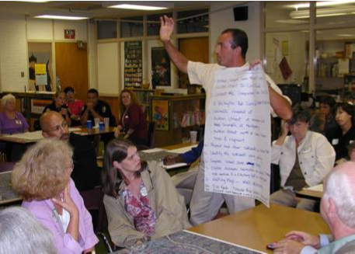
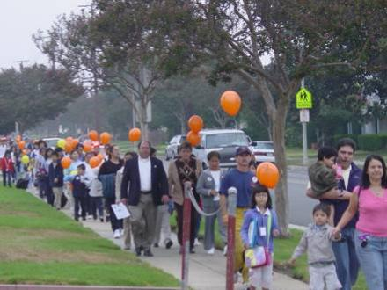
Good news!
Communities are taking action on behalf of children through Safe Routes to School
Winston-Salem, NC
Alhambra, CA
Phoenix, AZ
Notes:
Message:
It is time to focus on the positive. Communities are taking action on behalf of their kids.
Images:
(l) Latham Elementary School, Winston-Salem, NC, provided by Mike Cynecki;
(r) Ramona Elementary, Alhambra, CA, provided through www.iwalktoschool.org.

Slide 22
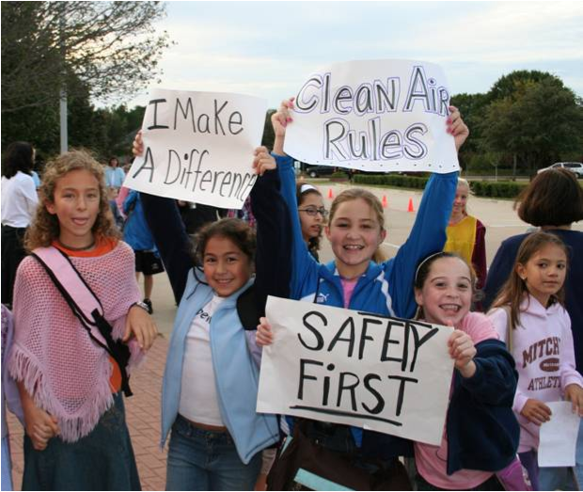
3. Safe Routes to School programs are part of the solution…
...to improve walking and bicycling conditions
...to increase physical activity
...to decrease air pollution
Dallas, TX
Notes:
Message:
Safe Routes to School programs can be part of the solution to making and walking and biking safer, which can in turn be an ideal strategy to increase physical activity among children and improve air quality.
Image:
Mitchell Elementary, Dallas, TX, provided through www.iwalktoschool.org.

Slide 23
More benefits of SRTS programs
Reduce congestion around schools
Can lead to cost savings for schools (reduce need for “hazard” busing)
Others: increase child’s sense of freedom, help establish lifetime habits, teach pedestrian and bicyclist skills
Notes:
Message:
There are other potential benefits of SRTS programs.
Other benefits include:
Reducing congestion around schools.
Saving money for schools (reduce need for hazard busing in which bus service is provided for children who live close to school because the routes are not safe for walking).
Increasing children’s sense of freedom, helping establish lifetime habits, teaching pedestrian skills and bicyclist skills.

Slide 24
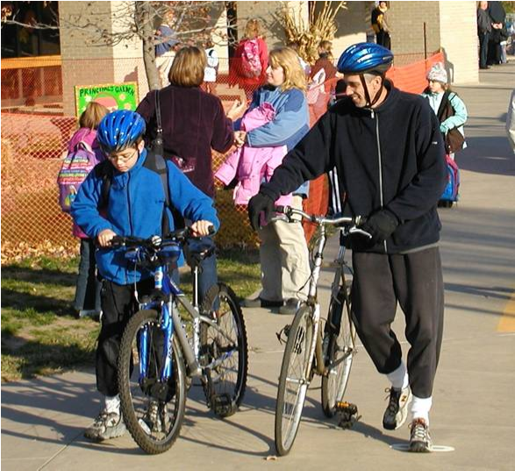
Elements of SRTS programs
Education
Encouragement
Enforcement
Engineering
Evaluation
Lenexa, KS
Notes:
Message:
Safe Routes to School Programs employ the E’s – engineering, education, enforcement, and encouragement – to help achieve its goals.
Evaluation is another element of the SRTS program and is used to identify what changes are happening while the program is underway.
Image:
Christa McAuliffe Elementary School, Lenexa, KS, provided by Mike Cynecki.

Slide 25
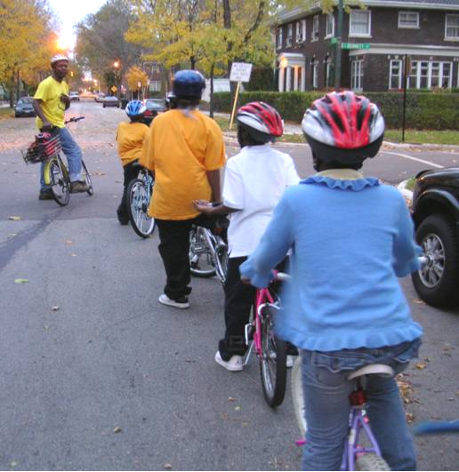
Education
Imparts safety skills
Creates safety awareness
Fosters life-long safety habits
Includes parents, neighbors and other drivers
Chicago, IL
Notes:
Message:
Education programs can have long lasting effects.
They teach students safety skills for walking and bicycling and inform parents and other drivers how to drive more safely around pedestrians and bicyclists.
The image here shows a Safe Cycling Training taught by the Chicagoland Bike Federation in Chicago, IL.
Image:
Chicagoland Bicycle Federation Safe Cycling Training, Chicago, IL, provided by Melody Geraci

Slide 26
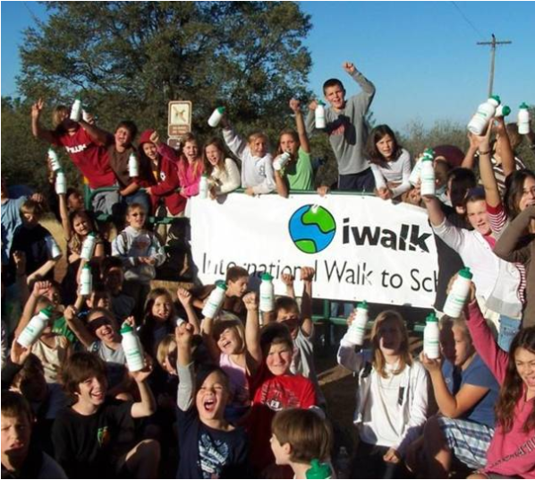
Encouragement
Increases popularity of walking and bicycling
Is an easy way to start SRTS programs
Emphasizes fun
Notes:
Message:
Encouragement strategies such as contests and rewards are an essential part of most Safe Routes to School programs.
They can be the easiest part of a program to start up and the emphasis is on having fun.
Image:
Northside Elementary, Placerville, CA provided by www.iwalktoschool.org

Slide 27
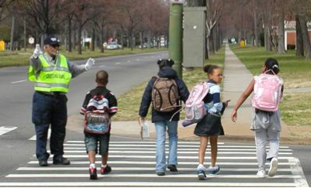
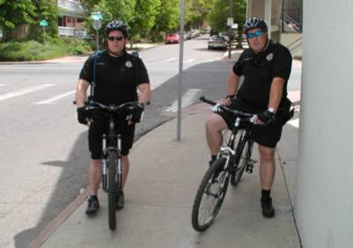
Enforcement
Increases awareness of pedestrians and bicyclists
Improves driver behavior
Helps children follow traffic rules
Richmond, VA
Denver, CO
Notes:
Message:
The primary goals of enforcement programs are to increase awareness of laws protecting children walking and bicycling and improve driver behavior (slower speeds, increased yielding to pedestrians).
The role of the police officer in the SRTS programs goes beyond enforcement and is often included in all phases of the program.
Others are involved in enforcement, too, like parents, schools, crossing guards and student safety patrols.
The officers shown in the lower image are present at Morey Middle School in Denver, CO everyday at dismissal time.
Images:
(t) Ginter Park Elementary, Richmond, VA, provided by Mike Cynecki;
(b) Morey Middle School, Denver, CO, provided by Mike Cynecki.

Slide 28
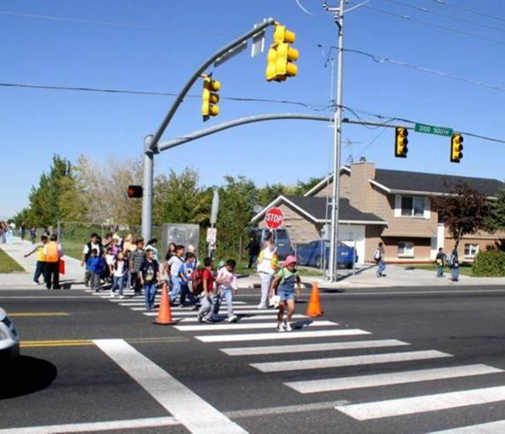
Engineering
Creates safer conditions for walking and bicycling
Can influence the way people behave
West Valley City, UT
Notes:
Message:
Engineering deals with the built environment and projects that work to create safer places to walk or bike.
The image here was taken at Monroe Elementary School in West Valley City, UT.
Image:
Monroe Elementary School, West Valley City, UT, provided by Mike Cynecki.

Slide 29
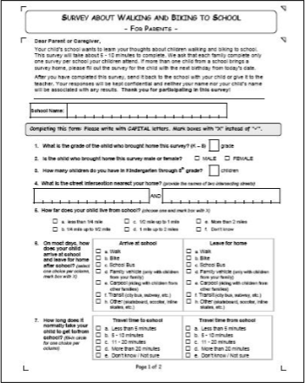
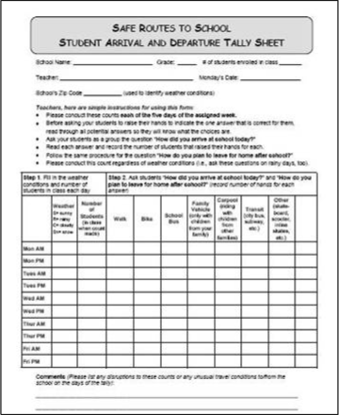
Evaluation
Is the program making a difference?
Notes:
Message:
Evaluation allows programs to track progress over time.
The examples shown here are tools used across the country to collect data about SRTS programs. They are available at www.saferoutesinfo.org/resources
Images:
National Center for Safe Routes to School, www.saferoutesinfo.org

Slide 30
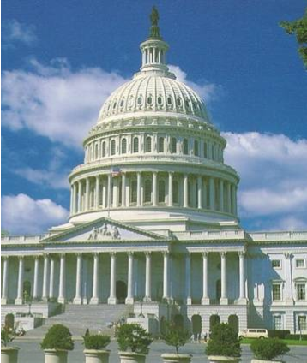
Federal Safe Routes to School program
$612 million to States 2005-2009
Funds infrastructure and non-infrastructure activities
Requires State SRTS Coordinators
More information:
www.saferoutesinfo.org
Notes:
Message:
Congress has established a federal SRTS program that provides $612 million to states for community SRTS projects.
$612 million for SRTS over five fiscal years (until 2009).
Eligible activities include infrastructure changes (ie, sidewalks, crosswalks, signs, signals, etc.) and non-infrastructure activities (ie education, encouragement, enforcement) for Kindergarten through grade 8 schools.
Each State has a SRTS coordinator or interim coordinator whose name can be found at www.saferoutesinfo.org.
The federal program also calls for a National Clearinghouse, which is called the National Center for Safe Routes to School (which provided this presentation material).
See the National Center web site at www.saferoutesinfo.org for more information.

Slide 31
State program
Insert state program info here
Notes:
Note to presenter:
Fill in state program information here.
To find State SRTS Coordinator contact information, go to www.saferoutesinfo.org/contacts
Image(s):

Slide 32
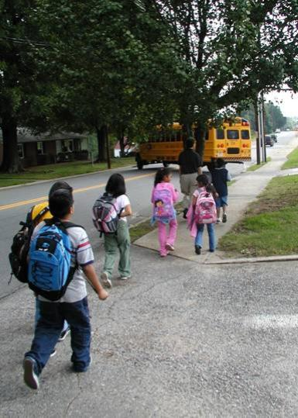
Safe Routes to School goals
Where it’s safe, get children walking and biking
Where it’s not safe, make changes
Winston-Salem, NC
Notes:
Message:
The goals of SRTS programs are to get more kids walking and bicycling where it is safe and to fix conditions where it is not safe.
The opportunity to bike and walk to school offers a solution to an array of concerns about traffic safety, traffic congestion, transportation costs, air pollution and lack of physical activity.
Image:
Latham Elementary School, Winston-Salem, NC, provided by Mike Cynecki.

Slide 33
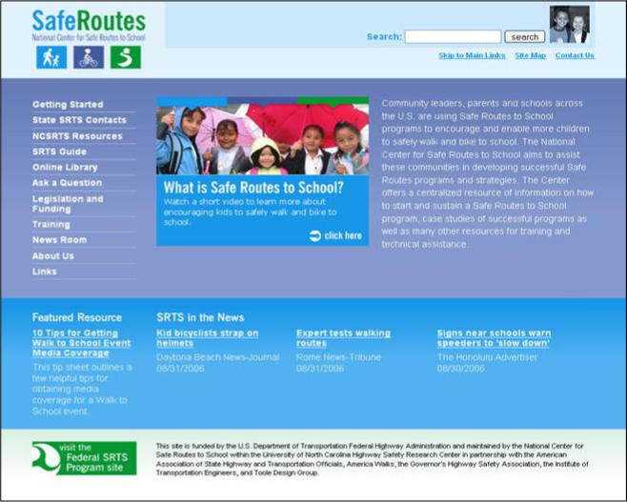
www.saferoutesinfo.org
Notes:
Summary:
The National Center for Safe Routes to School web site has tools to help communities plan and implement SRTS programs.
Thank you.
Image:
www.saferoutesinfo.org

