Slide 1
Publication No. FHWA-HRT-05-132
Comprehensive Approach: The 5 E’s
Lesson 24
Notes:
Lesson #: 24
Lesson Title: A Comprehensive Approach: Engineering, Education, Enforcement, Encouragement, and Evaluation
Learning Objectives:
Upon completion of this lesson, students will be able to:
Describe strategies for educating people about walking and bicycling.
Describe strategies for developing an effective program of enforcement of laws that will help pedestrians and bicyclists.
Describe strategies for encouraging people to walk and bike.
Preinstruction:
Present and explain the three lesson goals listed above.
Student Participation:
Have the students identify design an education, enforcement, or encouragement campaign for your community.
Followup:
Provide a summary of lesson 24.
Session Time: 30–35 minutes

Slide 2
Lesson Outline
Engineering practices.
Covered in previous lessons.
Education strategies.
Enforcement practices.
Encouragement strategies.
Program evaluation.
Notes:
Key Message: Provide the students with an overview of the lesson.
Est. Presentation Time: 1 minute
Suggested Comments:
This slide is optional.

Slide 3
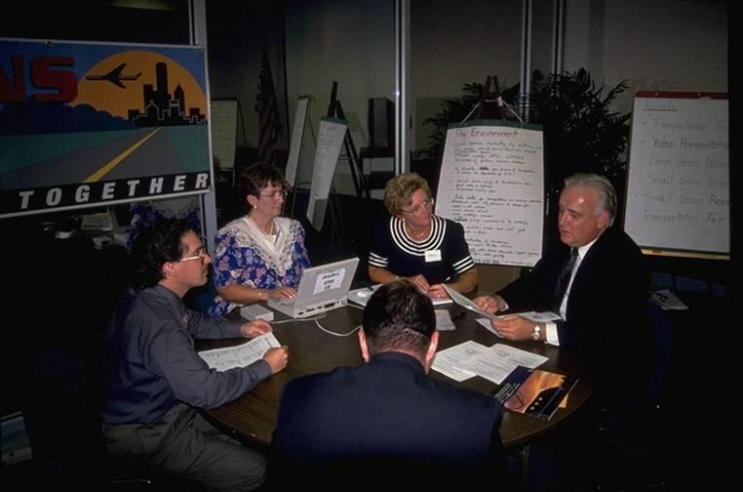
Comprehensive Approach
Collaborate with variety of stakeholders:
Public works.
Police.
School district.
Public health.
General public.
Bicyclists and pedestrians.
Etc.…
Notes:
Key Message: A comprehensive approach to bicycle and pedestrians programs brings together a variety of stakeholders.
Est. Presentation Time: 3–5 minutes
Suggested Comments:
In assembling a comprehensive bicycle/pedestrian program, the project managers should enlist the support and assistance of those who would ultimately be responsible for implementing it.

Slide 4
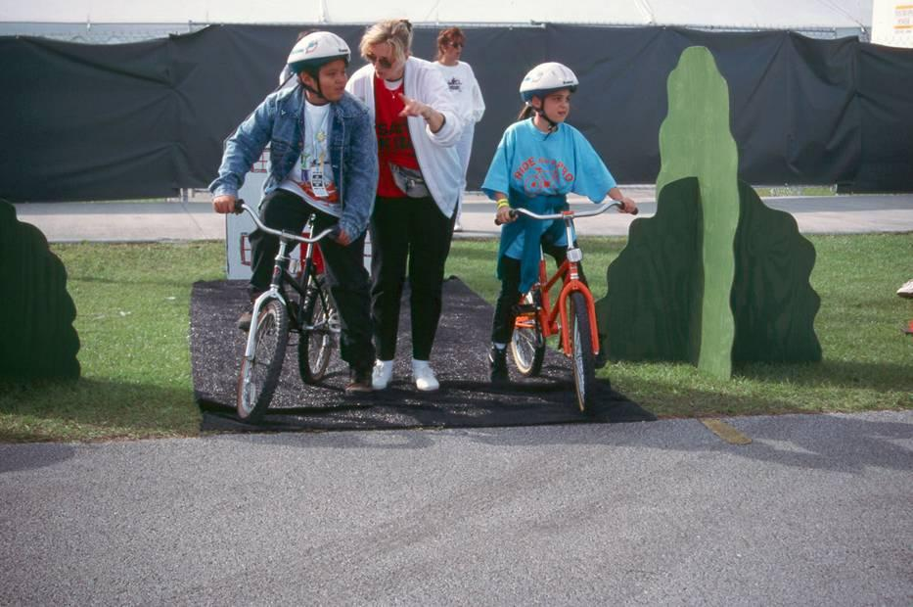
Education Strategies
Walking and biking skills for children.
Adult bicycle and pedestrian safety.
Motorist awareness.
Targeted safety messages.
Notes:
Key Message: Education strategies can be targeted at different groups to accomplish improved safety.
Est. Presentation Time: 3–5 minutes
Suggested Comments:
There are several education strategies that can be used to improve the safety of bicyclists and pedestrians. These strategies are multifaceted and address different types of users (children, adults) as well as other road users (motorists, truckers, etc.) and the general public.

Slide 5
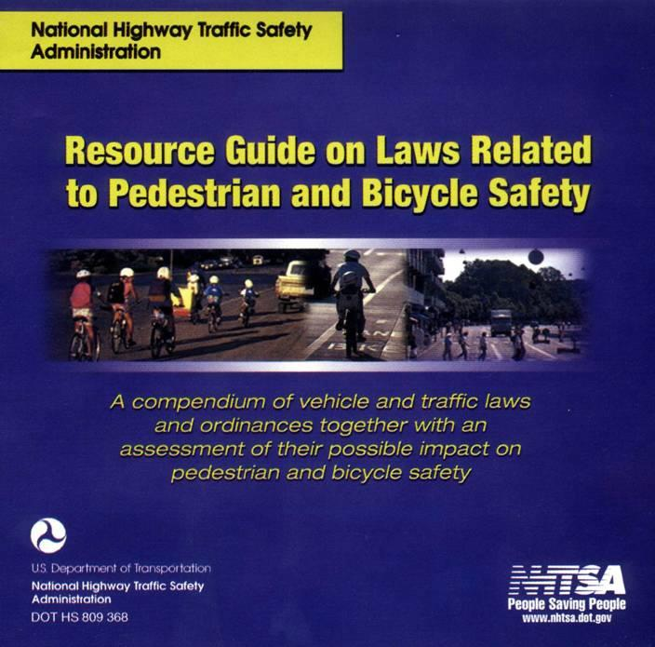
Enforcement Strategies
Enforce pedestrian/bike laws.
Review/modify existing laws.
Review/modify young violator practices.
Notes:
Key Message: Some enforcement strategies consider better enforcement of existing laws, whereas other strategies focus on modification of existing law to better accommodate bicyclists and pedestrians.
Est. Presentation Time: 3–5 minutes
Suggested Comments:
There are several enforcement-related strategies that could improve bicyclist and pedestrian safety. These strategies consider:
Better enforcing existing laws (yield to pedestrian in crosswalk, sharing the road, etc.);
Reviewing and modifying existing laws to improve safety and conditions; and
Reviewing existing enforcement practices to provide better education and reinforcement for young/at-risk violators.

Slide 6
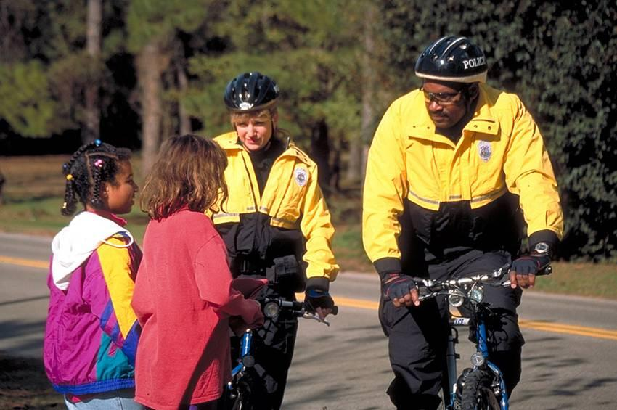
Enforcement Strategies
Reduce bicycle theft.
Reduce assaults on pedestrians and bicyclists.
Implement police bicycle patrols.
Notes:
Key Message: Other enforcement strategies focus on crimes against nonmotorized travelers.
Est. Presentation Time: 3–5 minutes
Suggested Comments:
Describe these other enforcement strategies. These strategies are important as a way to demonstrate that bicycling and walking is a safe activity in their community.
Police bicycle patrols have become more widely used in the last several years. Police find that with bike patrols, they are able to better circulate and patrol certain areas and may be more likely to detect crimes in progress because bikes are quiet. Bike patrols are also more conducive to patrolling areas where vehicle access is restricted or inconvenient.

Slide 7
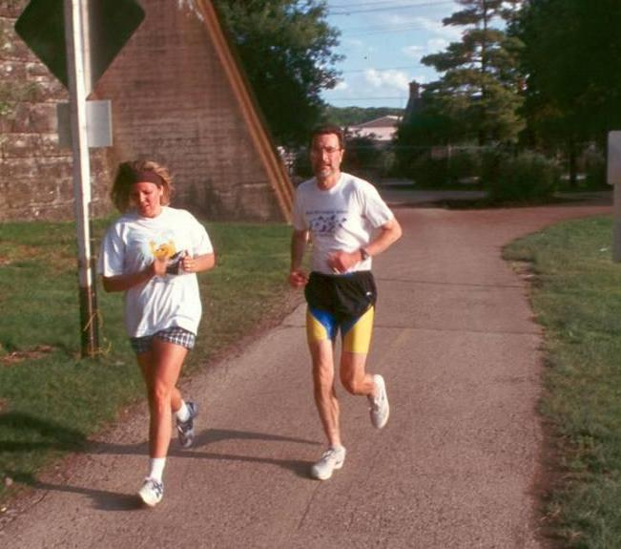
Encouragement Strategies
Market as a healthy lifestyle.
Promote through special events (bike-to-work day).
Inform target audiences.
Include walking and biking in local recreation programs.
Notes:
Key Message: Encouragement strategies focus on doing more than simply accommodating bicyclists and pedestrians on roads.
Est. Presentation Time: 3–5 minutes
Suggested Comments:
Encouragement strategies could have a significant impact on the number of people walking or biking. Many public health agencies and private foundations are getting involved in encouragement strategies, simply because of the physical inactivity epidemic that exists among many Americans. There are a number of excellent resources that have been prepared on encouragement strategies, chief among them, material developed by the Robert Wood Johnson Foundation and its numerous grantees (such as the National Center for Bicycling and Walking).

Slide 8
Program Evaluation
Continuous feedback:
Implement.
Evaluate.
Improve.
Demonstrate benefits of program:
Increase in walking/bicycling.
Decrease in congestion.
User satisfaction.
Notes:
Key Message: Evaluating your program is key to demonstrating its value to elected officials and other decisionmakers. Program evaluation is also helpful to provide feedback and set future direction.
Est. Presentation Time: 3–5 minutes
Suggested Comments:
Evaluating your program is key to demonstrating its value to elected officials and other decisionmakers. Program evaluation is also helpful to provide feedback and set future direction. In many public agencies, providing proof that a bicycle/pedestrian program is having an impact (through evaluation) will be essential to maintaining or increasing program budgets.

Slide 9
Lesson Summary
Campaigns related to education, enforcement, and encouragement can be effective means for increasing walking and bicycling.
Evaluation proves that you are making a difference.
Notes:
Key Message: Provide the students with an overview of the lesson.
Est. Presentation Time: 1 minute
Suggested Comments:
This slide is optional.

