Slide 1
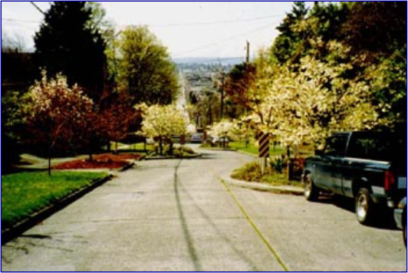
Traffic Calming
Publication No. FHWA-HRT-05-124
Lesson 20
Photo Source: PBIC, www.pedbikeimages.org
Notes:
Lesson #: 20
Lesson Title: Traffic Calming
Learning Objectives:
Upon completion of this lesson, students will be able to:
Cite the goals and objectives of traffic calming.
Describe the issues related to traffic calming.
List several types of traffic calming devices, along with some of the advantages and disadvantages associated with each.
Preinstruction:
Ask the class to present the results of their search to locate a local example of traffic calming. Ask them to report on the details they collected about the device (e.g., a dimensioned sketch) and give their critique of the device’s effectiveness.
Student Participation:
Use one of the activities provided in the Student’s Guide.
Followup:
Assign reading for lesson 21.
Have the students review and critique the latest version of the Manual on Uniform Traffic Control Devices (MUTCD) as it relates to accommodating pedestrians and bicyclists in work areas.
Session Time: 45–60 minutes

Slide 2
Lesson Outline
Need for traffic calming.
Goals and objectives of traffic calming.
Traffic calming issues.
Types of traffic calming devices.
2-2
Notes:
Key Message: Provide the students with an overview of the lesson.
Est. Presentation Time: 1 minute
Suggested Comments:
This slide is optional.

Slide 3
Need for Traffic Calming
Cut-through traffic.
Relatively high speeds in neighborhoods.
Determine the source of the problem.
Why do people cut through neighborhoods?
Traffic backup on main route.
More direct connection.
Why do people speed?
Make up time due to delay on main route.
2-3
Notes:
Key Message: Areas that are candidates for traffic calming may be suffering from a larger source of traffic congestion. Be sure to treat the disease, not the symptom, by examining the full context of the traffic situation.
Est. Presentation Time: 3 minutes
Suggested Comments:
Traffic-calming devices are used to control cut-through traffic and vehicles traveling at higher than desired speeds (typically through neighborhoods).
Before traffic-calming measures are implemented, you should determine the source of the cut-through and/or speeding problem. Can that problem be fixed? Typically, the cut-through traffic is a result of a backup on an arterial street. People do not want to be delayed, and they like a sense of movement, so they will turn off the main route and try to cut through a neighborhood to save time. Sometimes that means speeding to make up time due to a longer route or delay already incurred due to congestion. (See the figure on the next slide.)

Slide 4
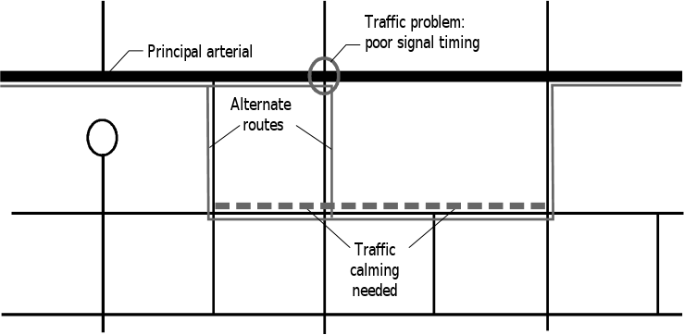
Need for Traffic Calming
2-4
Notes:
Key Message: This is a continuation of the previous slide with a visual example.
Est. Presentation Time: 3 minutes
Suggested Comments:
This figure shows an example of an area that is requesting traffic calming devices due to high volumes of fast-moving cut-through traffic. Shown within a greater context, it is clear that if traffic calming treatments were implemented, they would be treating a result of a problem but would not be addressing the true source of it.
To resolve this issue, look to major arterials surrounding the troubled area. Check the delay at signals, check signal timing efficiency, determine if adding turn bays or lanes of traffic would help, etc. Typically, the source of the problem is not difficult to find; the trouble lies in developing a good solution. Sometimes, when a community requests a traffic calming device, they already have a preset agenda and no other solution will be acceptable.
Be proactive. All the traffic calming in the world will not solve the problems of poor planning and design. Good access management policies and zoning reduce a lot of the cut-through and speeding problems in neighborhoods. Allowing developers to build residential areas on major thoroughfares is a recipe for disaster. Establishing multiple viable routes and/or a grid network of arterials with efficient signal timing will solve many of the problems and remove the need to install any traffic-calming devices.

Slide 5
Goals and Objectives of Traffic Calming
Increase safety by slowing vehicle speeds.
Improve street feel.
Enhance aesthetics.
Reduce crime.
Provide a balance among modes.
2-5
Notes:
Key Message: These are the primary goals of traffic calming.
Est. Presentation Time: 3 minutes
Suggested Comments:
Once it is determined that some sort of traffic calming device is needed, the above effects can be the result. Some of the techniques are used in the initial planning and design. However, a secondary goal of traffic calming is to provide adequate mobility on the main route. By slowing speeds, one result is that many cut-through vehicles are deferred to other primary routes. A typical result is a less-congested roadway that is more friendly to pedestrians and bicycles, providing a balance for various transportation modes. The slower traffic moves, the greater the perception of safety for pedestrians, and the greater the public activity on the street. This typically leads to lower crime and an improved feel of the street.

Slide 6
Goals and Objectives of Traffic Calming
Slows vehicle speeds.
Increases safety.
Accommodates motor vehicles.
2-6
Notes:
Key Message: Traffic calming has several goals, chief among them being to slow vehicle speeds and improve safety along and adjacent to the roadway.
Est. Presentation Time: 1 minute
Suggested Comments:
See section 20.2 of the Federal Highway Administration University Course on Bicycle and Pedestrian Transportation Student Workbook (Student Workbook) for additional details of these objectives.

Slide 7
Traffic-Calming Issues
Safety.
Impact of traffic operations.
Lack of proven design standards.
Liability.
Emergency/service vehicle access.
Impacts on bicycling.
2-7
Notes:
Key Message: Here are some important issues that must be addressed when planning for traffic calming.
Est. Presentation Time: 3–5 minutes
Suggested Comments:
Many issues with traffic calming are unfounded. Others are addressed below:
Safety: See table 20-1 for a discussion of these problems; good educational programs and vigilance in planning will help assure safety.
Traffic Operations: Planning and developing a network so that the vehicles travel on the roads that you want them to is the key. As long as it is the quickest and most direct route, then drivers will use it. Otherwise, like water, they will seek the path of least resistance.
Design Standards: Although design standards are an issue, not all the devices will work in all places. Driving populations are different in different areas; thus, the same devices will have not always have the same effects.
Liability: See table 20-1.
EMS Access: Regarding warrants and criteria for installation, primary access routes may not be eligible for certain types of devices.
Bicycle Impacts: Most concerns can be accommodated if bicycles are considered in the initial design criteria.

Slide 8
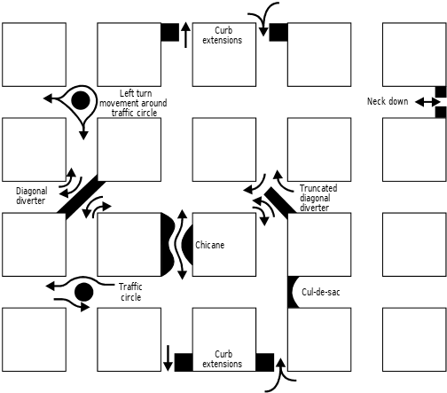
Traffic-Calming Treatments
2-8
Notes:
Key Message: The figure in this slide shows an integrated plan of many traffic calming devices.
Est. Presentation Time: 5 minutes
Suggested Comments:
Go through the different types of traffic calming devices in this diagram. Refer to the lesson for further examples and illustrations of real-life applications.

Slide 9
Types of Traffic-Calming Devices
Raised pavement areas.
Reduced street area.
Street closures.
Traffic diversion.
Texture and visual devices.
Parking.
2-9
Notes:
Key Message: Listed are examples of traffic calming devices.
Est. Presentation Time: 1 minute
Suggested Comments:
Ask the students if they have seen any of these devices implemented locally. What was their personal reaction to them? Were they aware of a general public reaction? Were there any problems or praises associated with them?

Slide 10
Combination Devices
Woonerf.
Entry treatments.
Slow streets.
Channelization.
Traffic calming on major roads.
Modified intersection design.
2-10
Notes:
Key Message: These devices employ several traffic calming techniques to achieve the desired effect.
Est. Presentation Time: 2 minutes
Suggested Comments:
Go into detail about these lesser-known, less defined devices and how they have emerged (refer to the lesson for more information).

Slide 11
Lesson Summary
Traffic calming is a viable alternative for having different types of transport share the street.
There are many types of traffic-calming devices and strategies from which to choose.
2-11
Notes:
Key Message: Summarize the lesson and discuss any questions or issues with students.
Est. Presentation Time: 3–5 minutes
Suggested Comments:
Summarize the lesson and discuss any questions or issues with students.

