Slide 1
Transportation Planning
Complete Streets
Context Sensitive Solutions

Slide 2
What is Transportation Planning?
Establishing a vision
Demonstrating influence or impact of demographics
Assessing future opportunities and challenges
Identifying short and long-term options
Source: FHWA

Slide 3
AGENCIES INVOLVED IN TRANSPORTATION PLANNING
Metropolitan Planning Organizations (MPO)
Regional and local transit providers
County or local transportation or public works agencies
City planning and engineering departments
Social service agencies
Representatives from state transportation and environmental protection agencies
Special authorities such as parking, airport, port, or recreational districts
Enforcement agencies
Ride-sharing/Commute options organizations
Source: Tom Fox, MATA

Slide 5
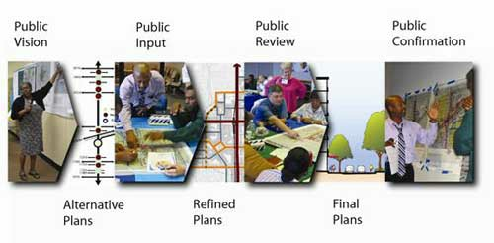
The Planning Process
Source: Google Images

Slide 6
Context Sensitive Solutions
Context sensitive solutions (CSS) is a collaborative, interdisciplinary approach that involves all stakeholders in providing a transportation facility that fits its setting. It is an approach that leads to preserving and enhancing scenic, aesthetic, historic, community, and environmental resources, while improving or maintaining safety, mobility, and infrastructure conditions.
– Results of Joint AASHTO / FHWA Context Sensitive Solutions Strategic Planning Process, Summary Report, March 2007

Slide 7
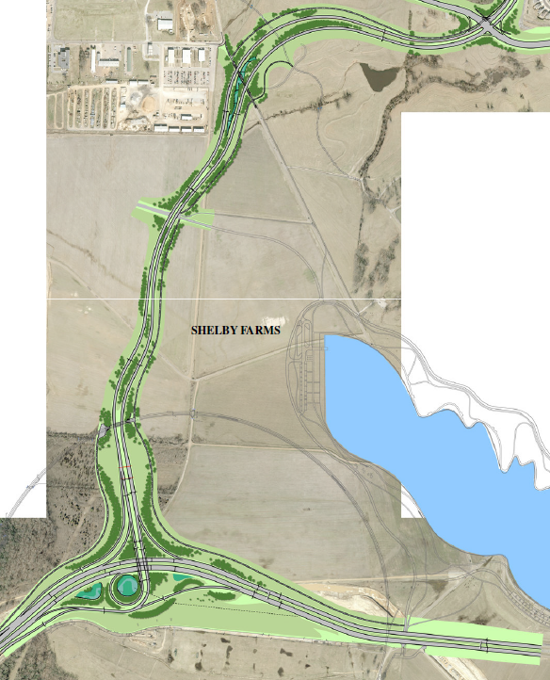

Slide 8
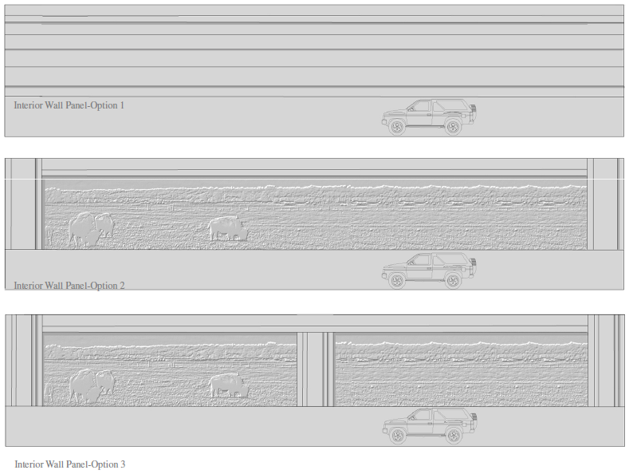

Slide 9
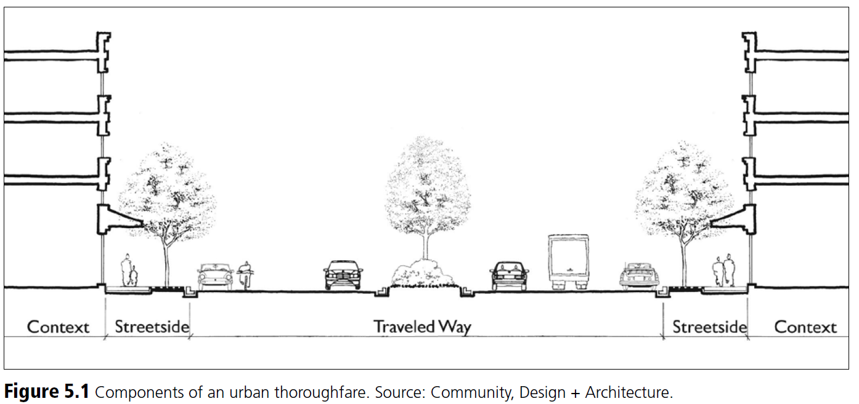

Slide 10
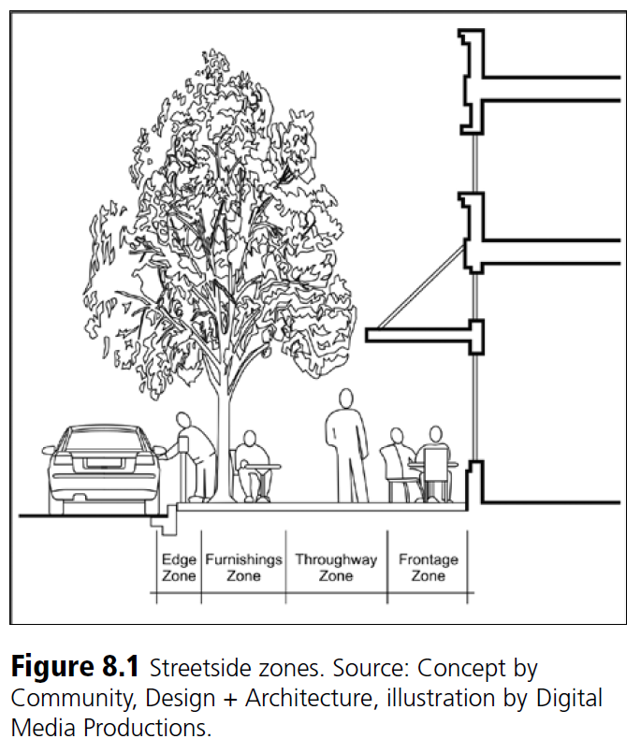

Slide 11
Complete Streets
Complete Streets are safe, comfortable, and convenient for travel for everyone, regardless of age or ability – motorists, pedestrians, bicyclists, and public transportation riders.
Source: www.completestreets.org

Slide 12
Source: www.memphis.edu

Slide 13
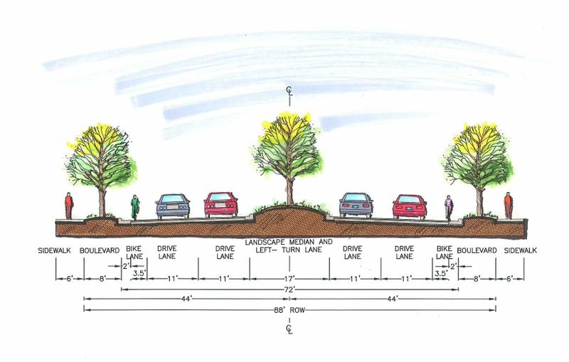
Source: Google Images

Slide 14
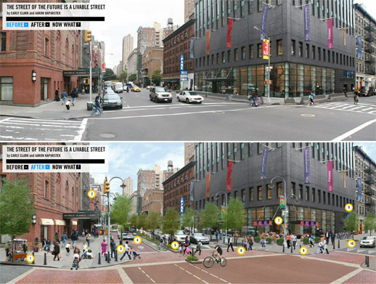
Source: Google Images

